Slide 1


Welcome
Linda Robinson
Chief Executive
Age NI

Slide 2


NI Frailty Network
Our Journey So Far…
Sandra Aitcheson,
Assistant Director of Nursing,
Public Health Agency
e: frailtynetwork@hscni.net

Slide 3

Our Aim
To develop a regional approach to frailty
using principles of collective leadership
Objectives:
To work in partnership with service users and other stakeholders through co-production methodology in order to:
To agree a NI Vision for the management of frailty
To develop a workable regional strategy for HSC that supports joint processes for commissioning and delivery of services that impact frailty
To put in place a structure which supports the planning, design, commissioning and evaluation of a frailty pathway for NI
e: frailtynetwork@hscni.net

Slide 4

Frailty is everybody’s business and
everybody should know what to do next
when presented with a person
living with frailty
e: frailtynetwork@hscni.net

Slide 5

Stocktake
Age NI Report – Rethinking Frailty
Transformation Funding
Partnership with Age NI – Co-Production
Network launched March 2019
Network Co-ordinator Appointed
Evidence Review
Scoping Study - ICPs

Slide 6

We have come a long way, but we still have further to go

Slide 7
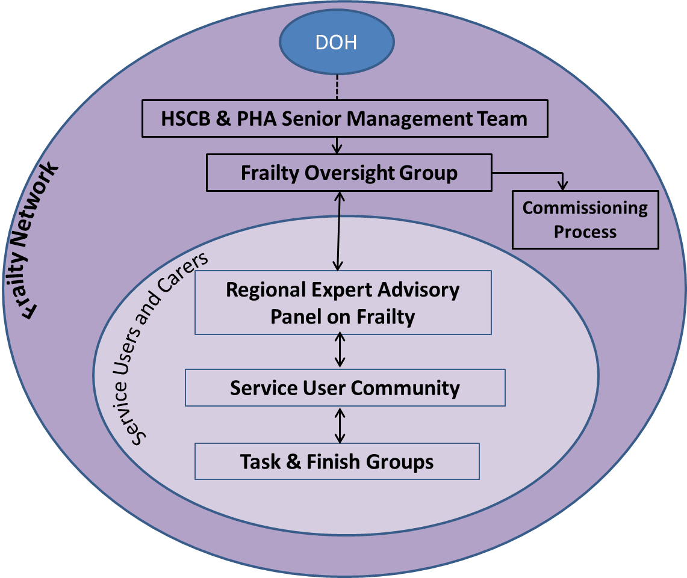
Since the Launch of the Network:
Structure
Oversight Group
Expert Advisory Panel
Service User Community
Review of Evidence Completed

Slide 8
Learning & Development:
  ECHO (Enhanced Community Health Outcomes)
  Clinical Education Centre – Introduction to Frailty Programme
NHS Benchmarking Audit – Managing Frailty in Acute Settings – NI Report Winter 2019/20
Frailty Network Logo Design
6 Frailty Prototypes
Health Economist

Slide 9
Task and Finish Groups:
  Regional Framework/Pathway
  Public Health Messages
  Identification
  Assessment Tools
  Education
NI Frailty Roadmap
Links with other areas – Europe (JA Advantage), RoI, NHS
Ageing Well Focus – Booklet for NI
Website

Slide 10
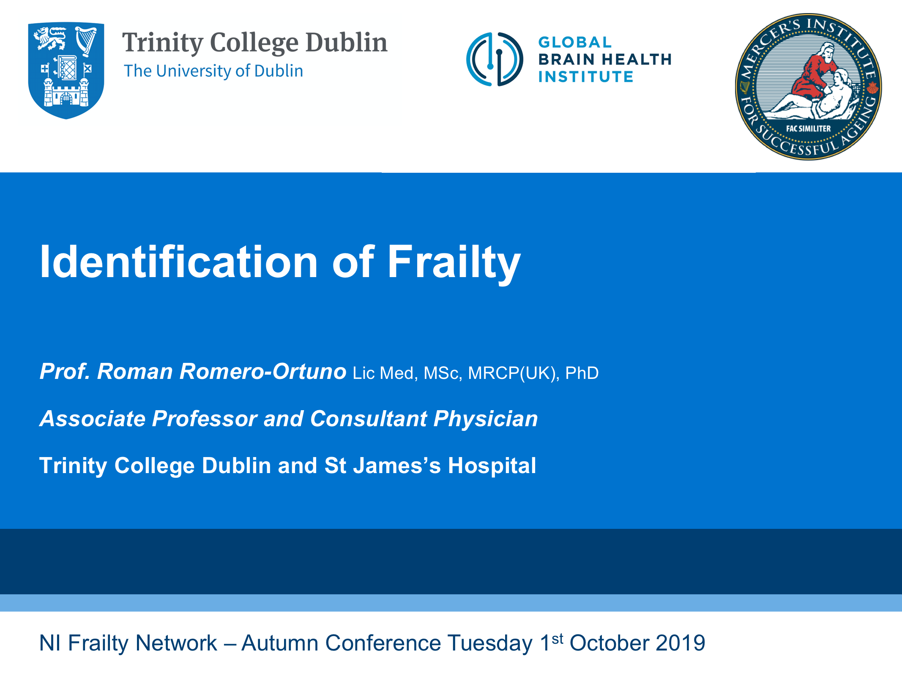
Identification of Frailty
Improvement and research in practice
3rd annual Improvement Science PhD summer school
Friday 15th September 2017
Clare College Conferencing Cambridge
Dr. Roman Romero-Ortuno Lic Med, MSc, PhD, MRCP(UK)

Slide 11
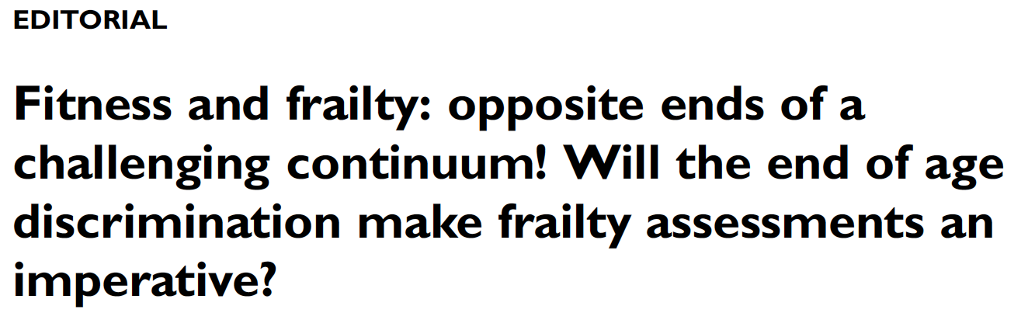
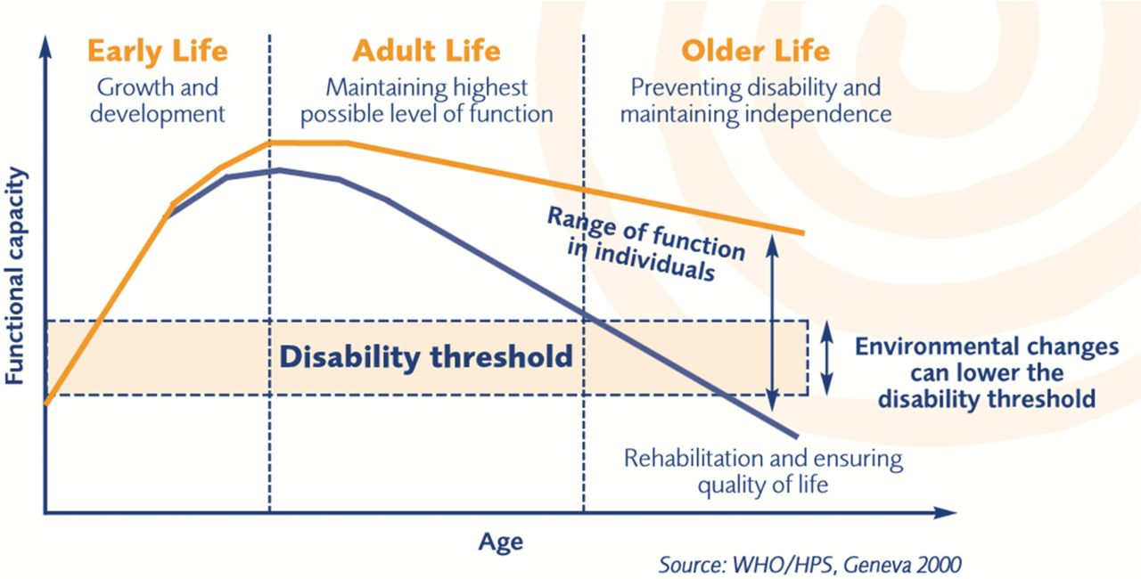

Heterogeneity in ageing
For a surprisingly large segment of the older population, chronological age is not a relevant marker for understanding, measuring, or experiencing ageing.
Instead, the concepts of biological age or fitness-frailty spectrum may be more useful.

Slide 12
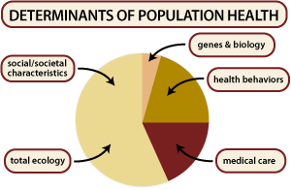

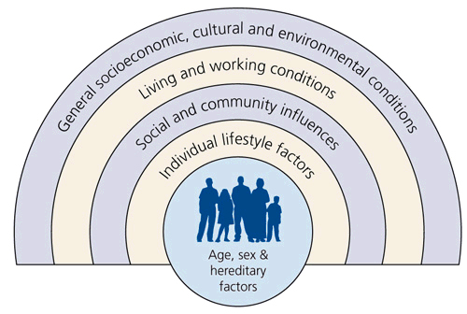
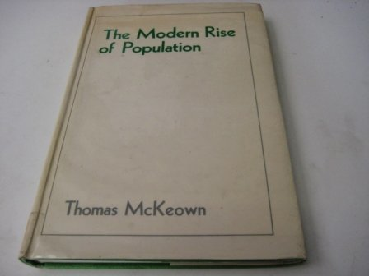
Heterogeneity in biological ageing is driven by the determinants of health

Slide 13
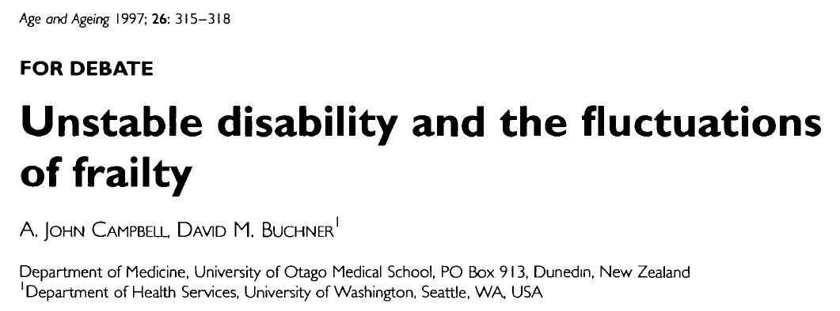
Frailty: the clinical concept
‘A condition or syndrome which results from a multi-system reduction in reserve capacity to the extent that a number of physiological systems are close to, or past, the threshold of symptomatic clinical failure.
As a consequence the frail person is at increased risk of disability and death from minor external stresses'.

Slide 14
Acute illness, trauma
ROBUST
Functional abilities
Independent
FRAIL
Dependent
Time
Clegg A et al. Frailty in elderly people. The Lancet 2013; 381:752-62

Slide 15
Frailty: clinical operationalisations
  Index approach (frailty as a state)
  Phenotypic approach (frailty as a syndrome)
  The Clinical Frailty Scale

Slide 16
Frailty as a state: the frailty index

Slide 17
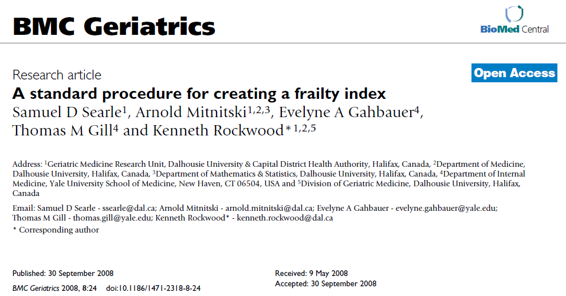

Slide 18

40 deficits for a FI in SHARE
Difficulties: bathing or showering | Difficulties: lifting or carrying weights | Moderate or vigorous physical activity: hardly ever, or never | High blood pressure | Hip or femoral fracture
Difficulties: dressing | Difficulties: shopping for groceries | Diminution in the desire for food and/or eating less than usual | Heart attack | Impaired orientation to date, month, year and day of week
Difficulties: getting up from chair | Difficulties: doing work around the house or garden | Poor self-perceived health | Stroke | Body mass index (Kg/m²) deficit
Difficulties: walking across a room | Difficulties: preparing a hot meal | Long-term illness | Cancer | Breathlessness
Difficulties: eating, cutting up food | Difficulties: taking medications | Fatigue | Diabetes | Falls
Difficulties: reaching or extending arms above shoulder | Difficulties: managing money | Sad or depressed | Arthritis | Fear of falling
Difficulties: using the toilet | Difficulties: walking 100 metres | Lack of enjoyment | Chronic lung disease | Dizziness, faints or blackouts
Difficulties: climbing one flight of stairs | Difficulties: getting in or out of bed | Hopelessness | Osteoporosis | Grip strength (Kg) deficit

Slide 19
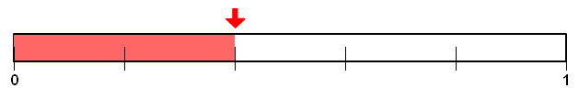
Frailty Index (FI)
Sum of deficits
___________________
Total number of variables

Slide 20
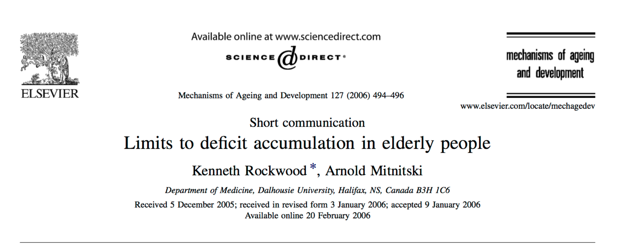
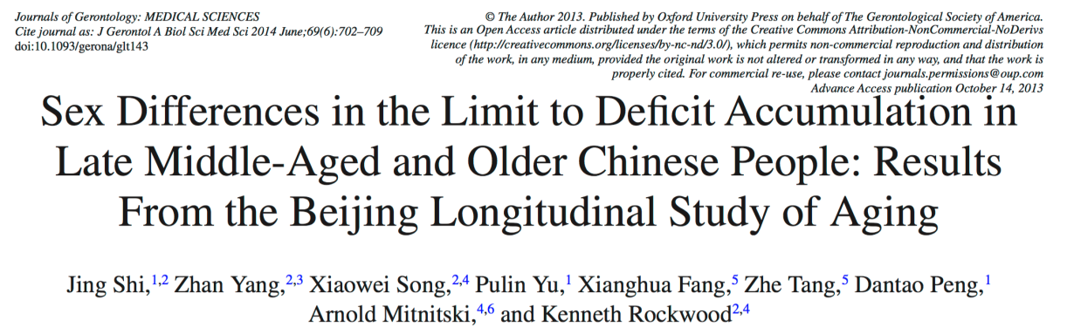
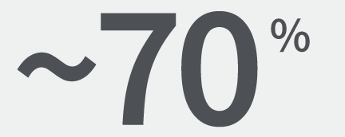

Slide 21
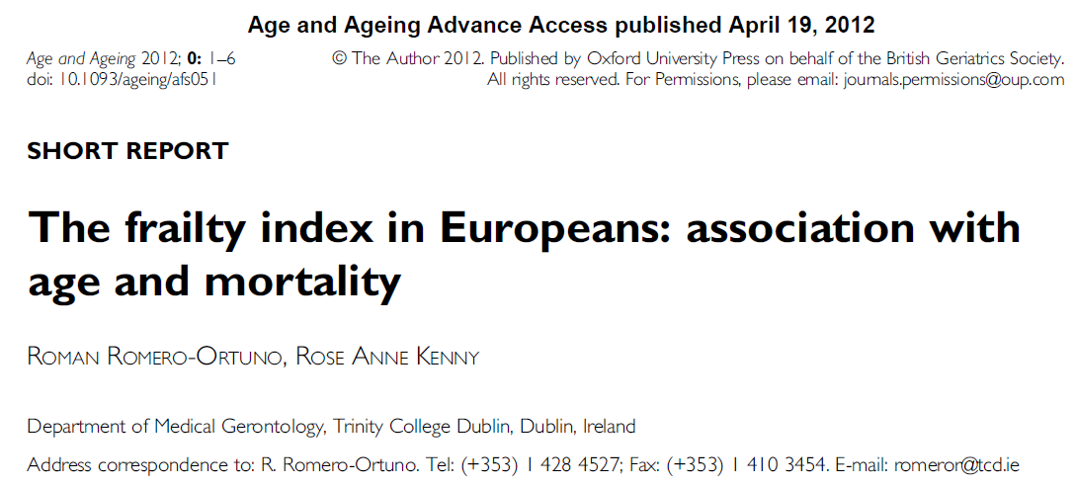


Slide 22
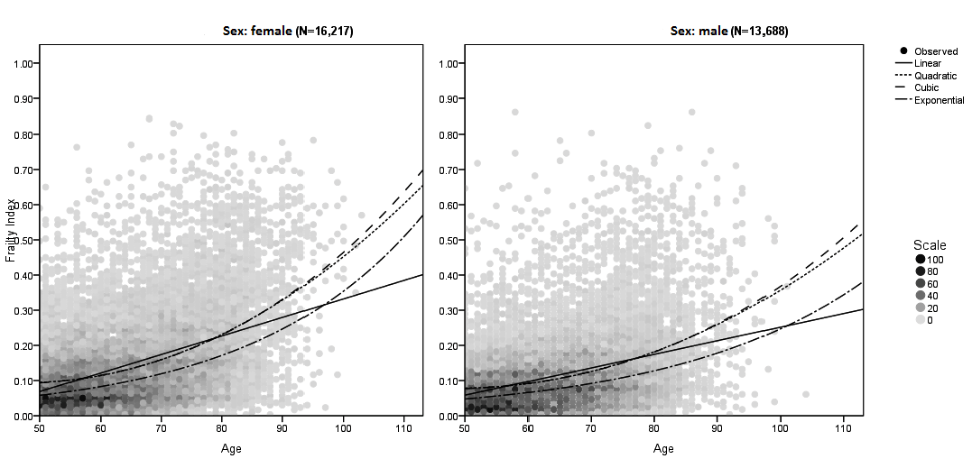

FI: association with age
Females: quadratic R² = 0.200, P < 0.001 Males: quadratic R² = 0.136, P < 0.001
Romero-Ortuno & Kenny. Age and Ageing, 2012

Slide 23


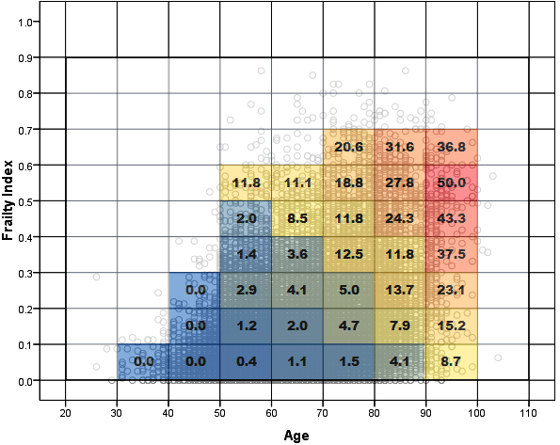
Population heterogeneity
Association of the SHARE frailty index with mortality (mean follow up: 2.4
years) by age decade and tenth of FI, in SHARE wave 1 (men and women combined, total N = 20,547). The number on each coloured cell represents the mortality rate (%) for that cell.
YOUNG
OLD
FRAIL
FIT

Slide 24
Frailty as a syndrome: the frailty phenotype

Slide 25
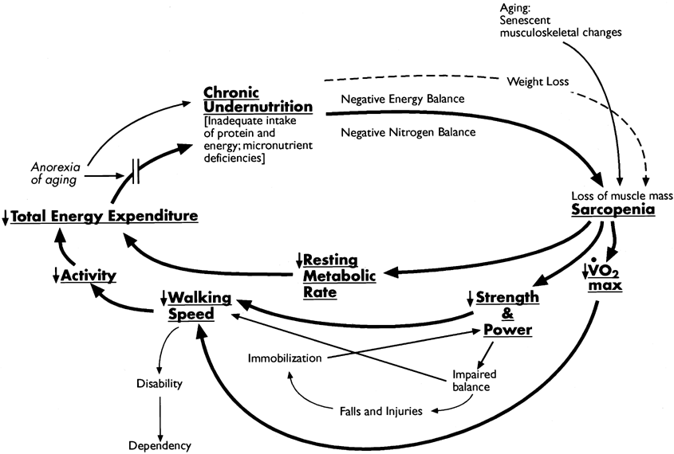
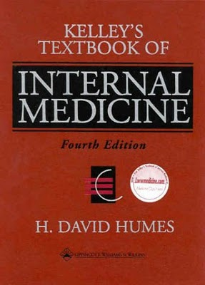
Frailty:
a phenotypic approach
(Fried and Walston, 2000

Slide 26
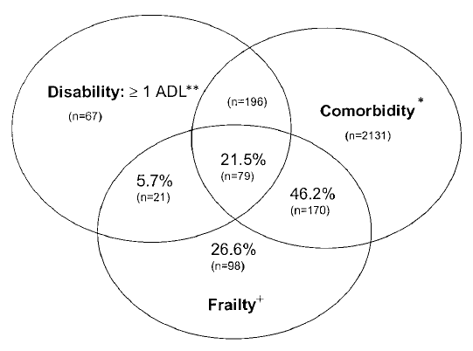
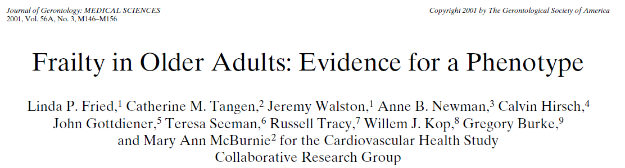
Frailty phenotype vs. comorbidities, disability

Slide 27
Exhaustion
Weakness
Low physical activity
Slowness
Unexplained weight loss
Frailty phenotype
1 or 2: pre-frail
3 or more: frail
Fried L et al. Frailty in older adults: evidence for a pheynotype. J Gerontol A Biol Sci Med Sci. 2001; 56:M146-56.

Slide 28
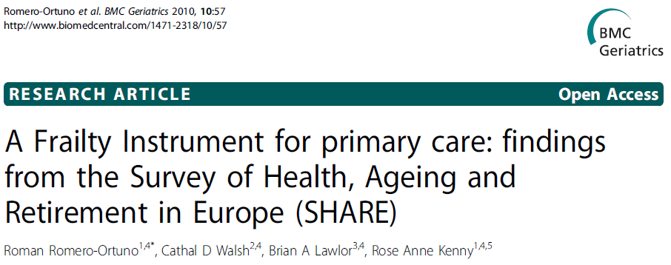
Includes open access online
frailty calculators, by gender

Slide 29
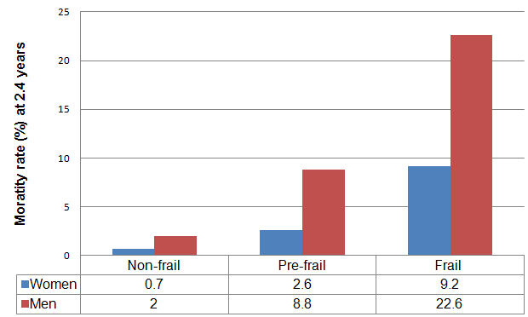

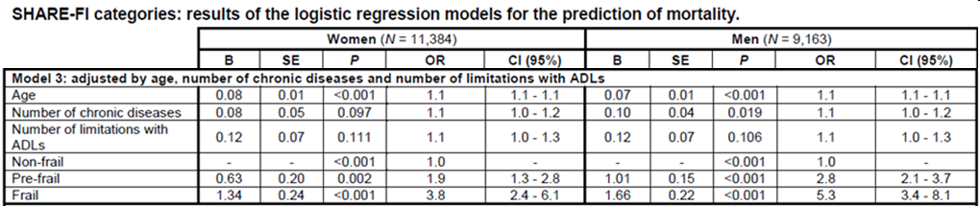
SHARE-FI: associated mortality

