Slide 1
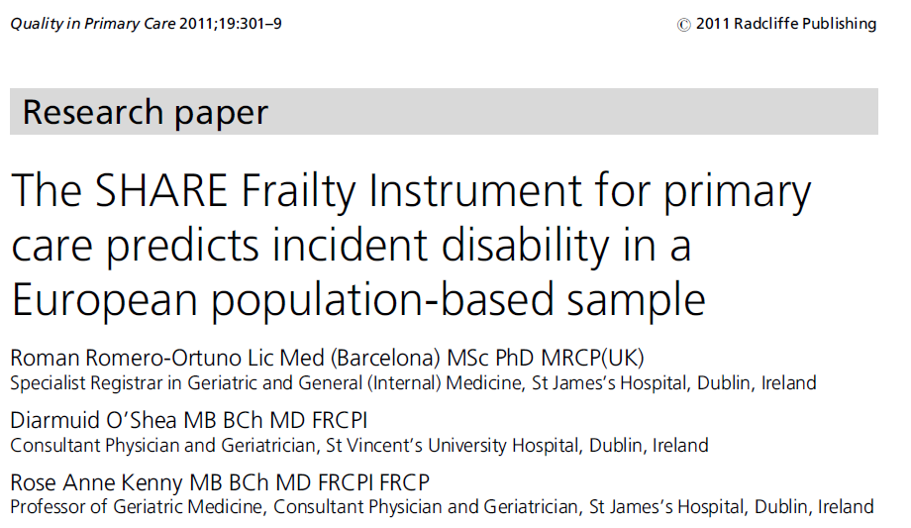

Further validation: incident disability (Total SHARE sample N = 28,361)
By wave 2, 3.6% of the non-frail, 12.2% of the pre-frail and 30.4% of the frail had increased the number of ADL disabilities by at least one.
Likewise, 6.6% of the non-frail, 20.4% of the pre-frail and 36.6% of the frail had, by wave 2, increased the number of IADL disabilities by at least one.

Slide 2

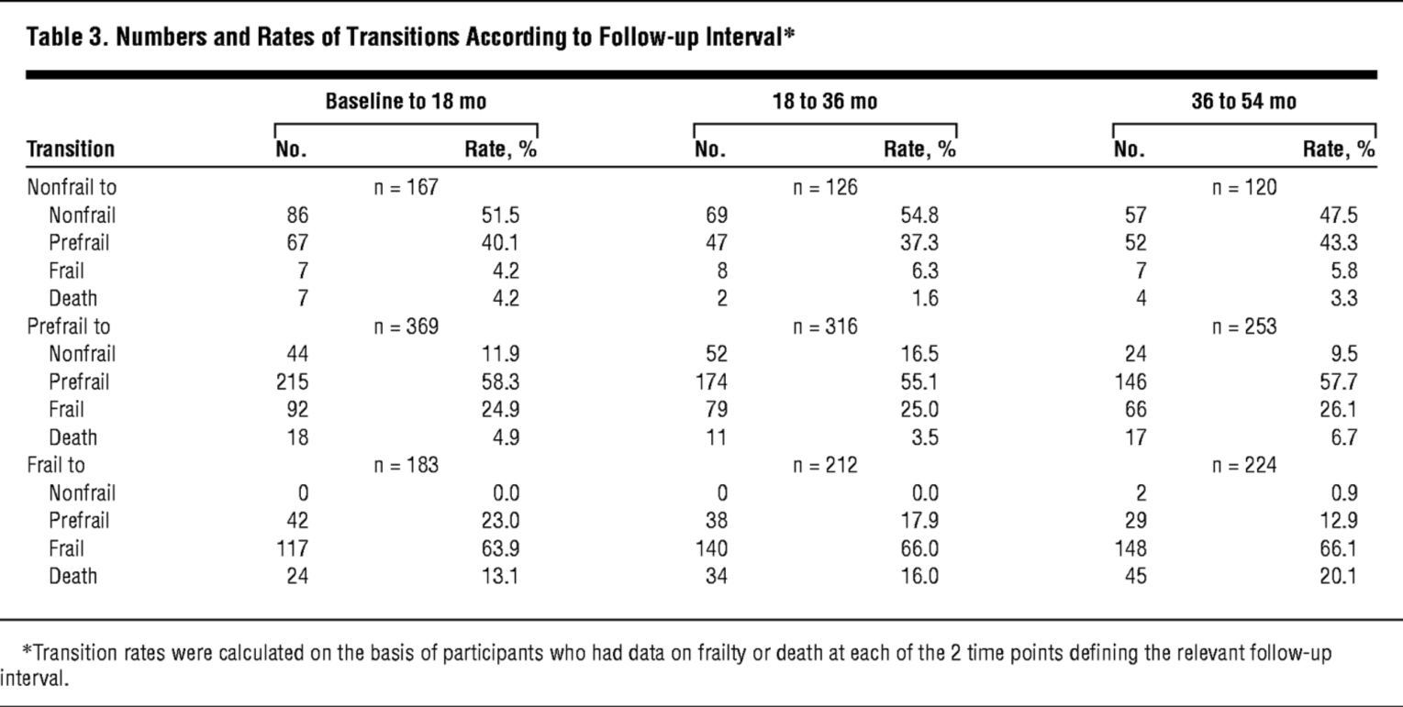
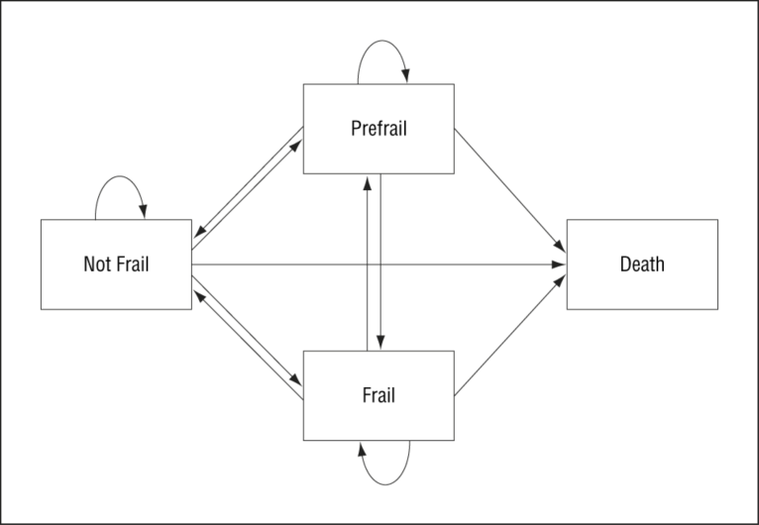
From: Transitions Between Frailty States Among Community-Living Older Persons
Arch Intern Med. 2006;166(4):418-423. doi:10.1001/archinte.166.4.418

Slide 3
A judgement-based measure:
The Clinical Frailty Scale

Slide 4
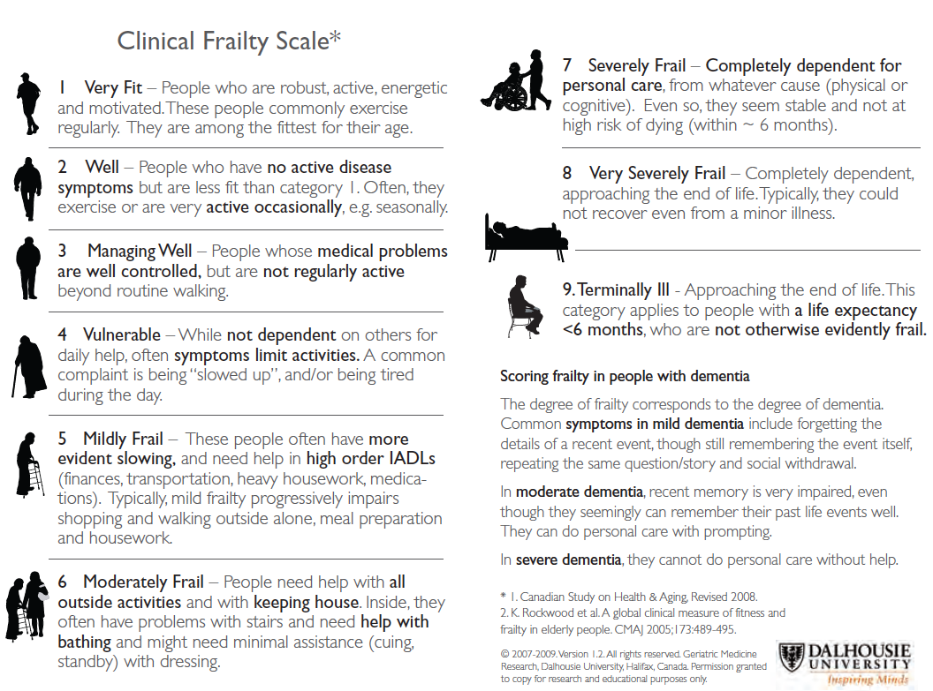
At CUH we utilise the Clinical Frailty Scale (K Rockwood)
Advantages : fast, can be undertaken in ED, intuitive
Disadvantages : oversimplified?, scores may change during stay?

Slide 5
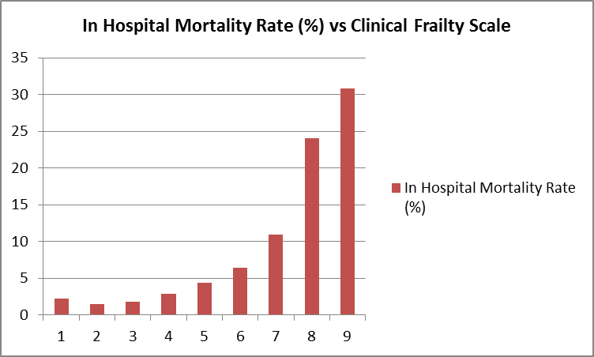
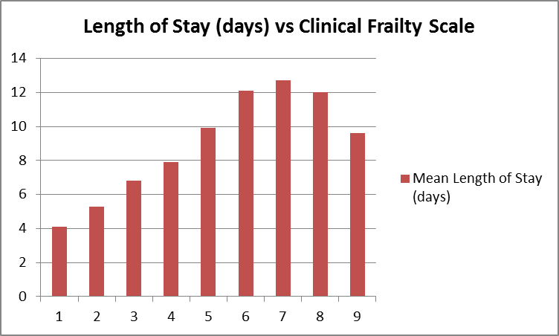


Association of the Clinical Frailty Scale (CFS) with Hospital Outcomes in a Large Retrospective Cohort of Non-Elective Admissions Aged ≥ 75 Presenting to a Tertiary University NHS Hospital
Wallis S, Wall J, Biram R and Romero-Ortuno R, QJM 2015
n = 5764, age adjusted P for trend < 0.001

Slide 6
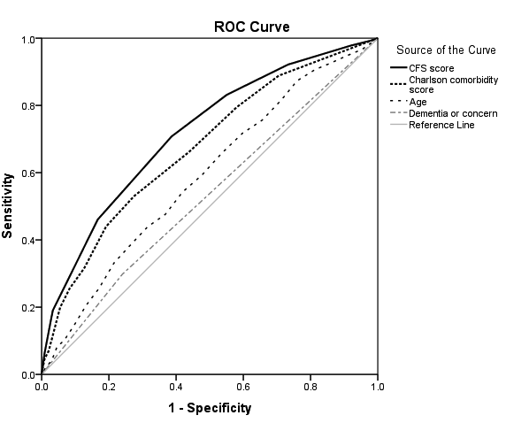

Association of the Clinical Frailty Scale (CFS) with Hospital Outcomes in a Large Retrospective Cohort of Non-Elective Admissions Aged ≥ 75 Presenting to a Tertiary University NHS Hospital
n=5763
n=5764, age adjusted P for trend < 0.001
ROC curves for the prediction of in-patient mortality. Areas under the curve (AUC) with 95% confidence intervals (CI) were: CFS: 0.72 (0.70 – 0.75, P < 0.001), Charlson Comorbidity score: 0.67 (0.64 – 0.70, P < 0.001), age: 0.59 (0.56 – 0.62, P < 0.001), history of dementia and/or current cognitive concern: 0.53 (0.50 – 0.56, P = 0.076).
Wallis et al, QJM 2015

Slide 7
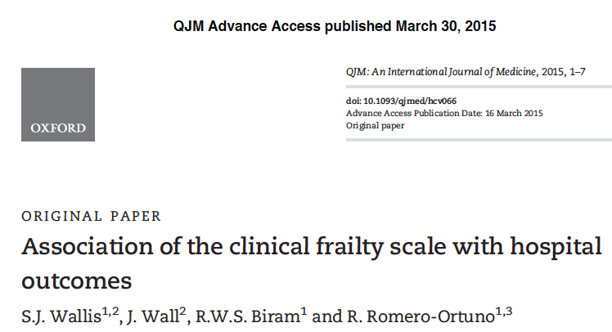

Slide 8



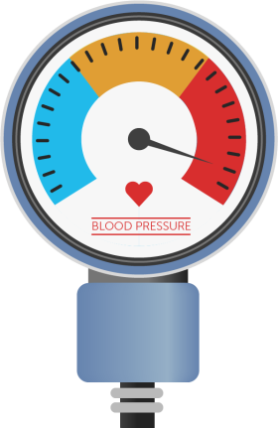



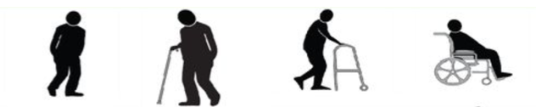
In-patient mortality for non-elective admissions in patients aged 75+
(n= 5,505)
% mortality
24
Low acuity
20
High acuity
Deep learning on e-hospital records
16
13
8
4
0
Romero-Ortuno et al. European Journal of Internal Medicine 2016; 35:24.34
Notes:
Redraw the graph

Slide 9
Which frailty assessment tool?

Slide 10
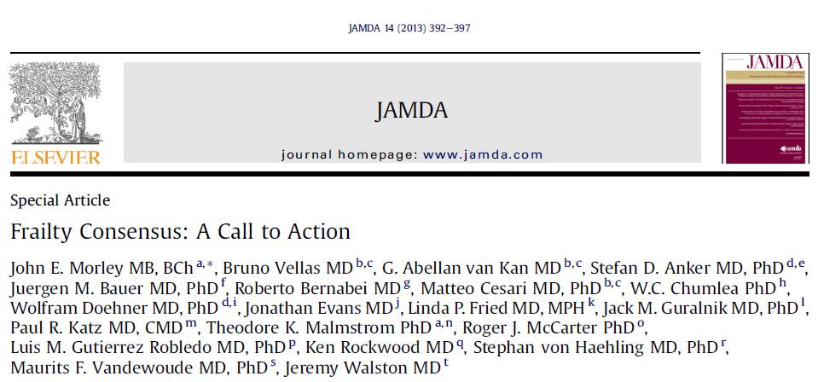
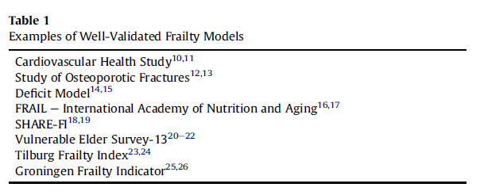

Slide 11
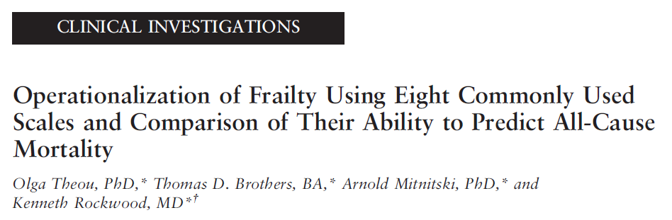

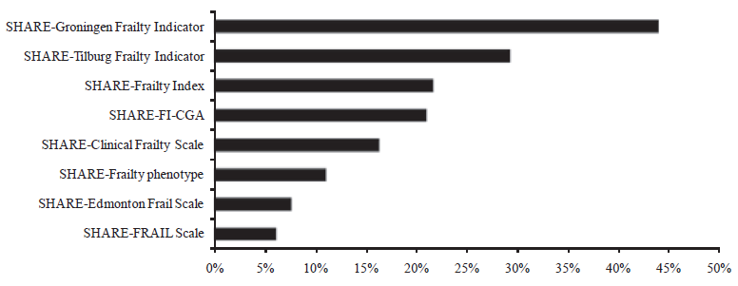
Article first published online: 26th August 2013
Prevalence of frailty in SHARE

Slide 12
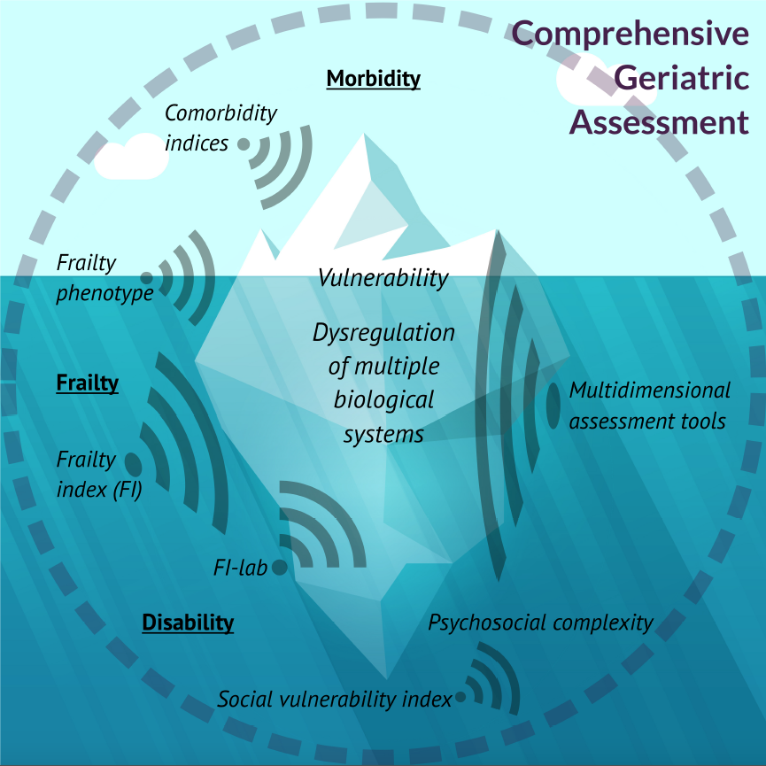
Which part of the bigger picture are you looking at?

Slide 13
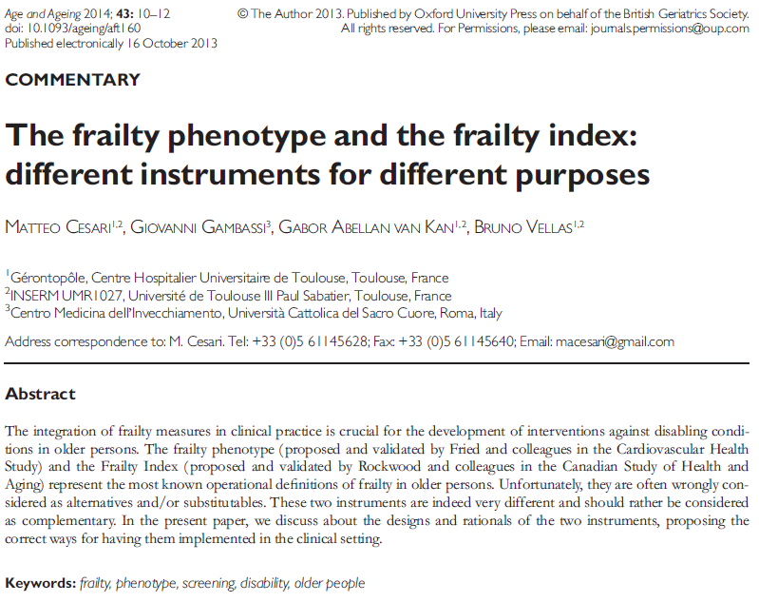

Slide 14
Geriatric Giants
Frailty
Comorbidity
Cognition
Acuity
Social
“Giants are large and powerful. If they are to be confronted, they must be taken seriously. For this, recognition is an essential first step.”
(Kenneth Rockwood, 2016)

Slide 15
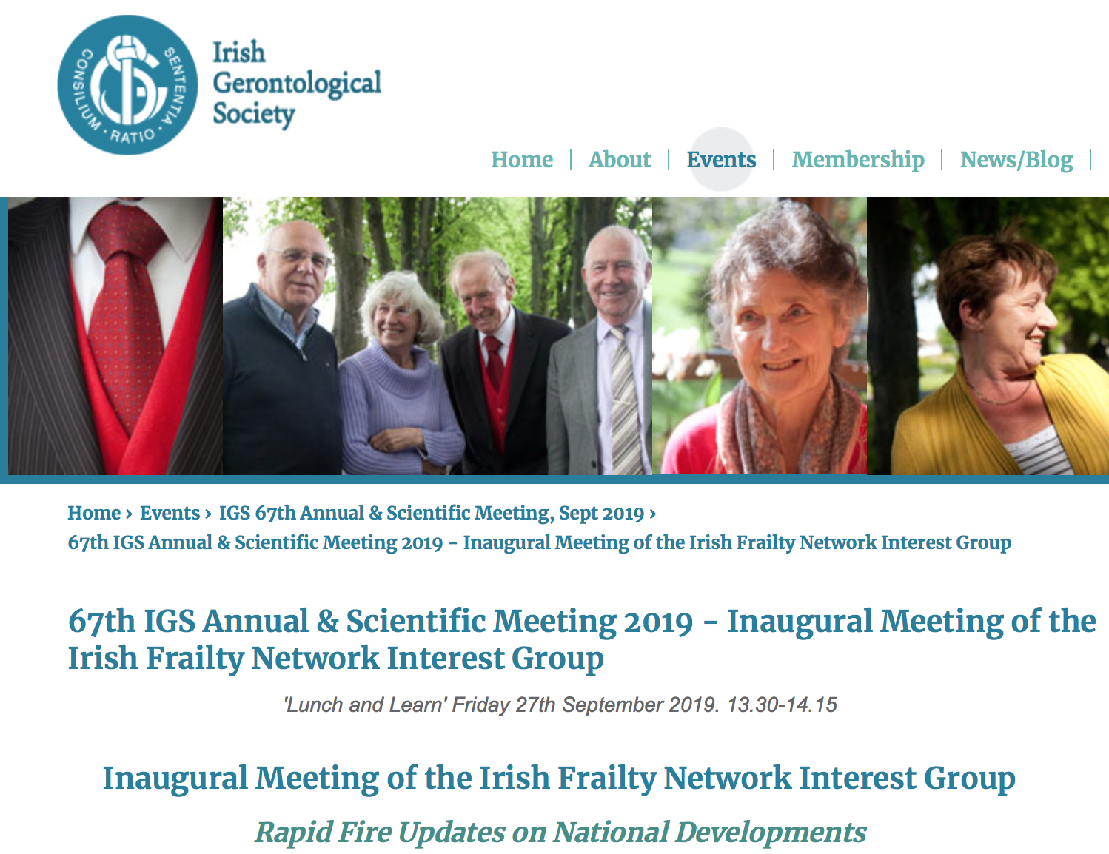

Slide 16
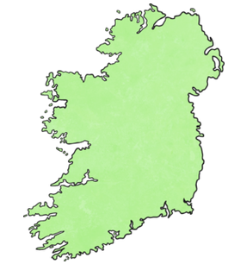

The time is right for an
Irish Frailty Network
Education
Improvement
Research
Policy

Slide 17
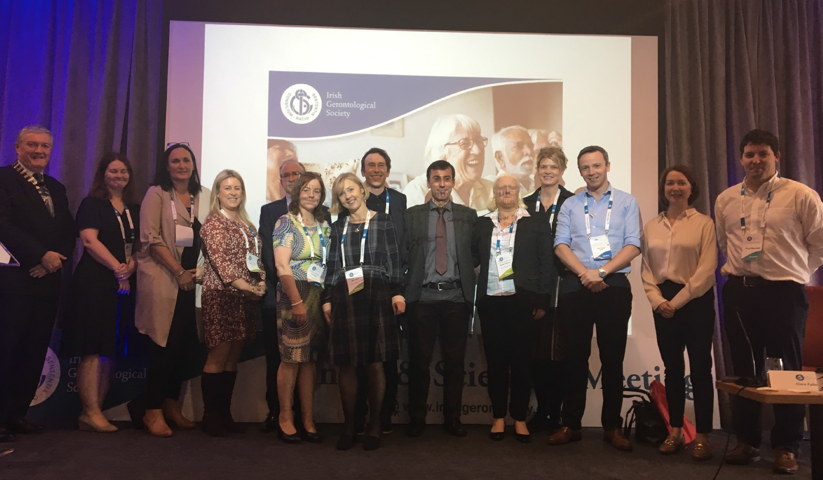
Irish Frailty Network interest group
From left: Diarmuid O’Shea (IGS President), Therese Cooney (Dublin), Jane Nolan (Kilkenny), Deirdre Lang (National Director of Nursing), Sean Kennelly (Dublin), Mai Olden (IGS), Mary O’Shea (TILDA), Rónán Ó Caoimh (Galway), Román Romero Ortuño (Dublin), Aisling O’Halloran (TILDA), Emer Ahern (Cork), John Cooke (Waterford), Siobhán Kennelly (National Clinical Advisory Group Lead), Paul Bernard (Dublin). Not in the picture: Paul Maloney (Dublin), Helen Whitty (RCPI), Rose Anne Kenny (Dublin).

Slide 18

Technology Enabled Care – Supporting people to live active, safe and healthy lives as independently as possible
Claire Büchner
Assistant Director Digital Health & Nursing
Notes:
Technology is already transforming the way we live our lives – at home, in how we interact socially and at work. Technology offers massive potential to realise our ambitions to shift the focus of our health and care system from crisis intervention towards prevention, enablement and supported self-management as outlined in Health and Wellbeing 2026 – Delivering Together launched in October 2016 by the Department of Health.
The new Digital Health and Care Strategy for Northern Ireland will recognise the contribution of technology enabled care (TEC) to date and will set out an ambitious set of priorities. This presentation will outline ongoing projects and innovation programmes in this area and how this will be further developed as a key element of service transformation to support people going forward. The question is no longer about proving the value and potential of technology enabled care – rather it is about understanding how to achieve widespread adoption so that TEC and digital are the default and ‘business as usual’.

Slide 19
What will we talk about?
TEC as an enabler to care
Strategic direction
  Connected Patients - shifting the balance of power
  Connected Providers – changing ways of working
Where are we now?
Where would we like to go?
How might we get there?
Notes:
Connected health or technology enabled care (TEC) is the collective term for telecare, telehealth, telemedicine, mHealth, digital health and eHealth services. TEC involves the convergence of health technology, digital, media and mobile telecommunications and is increasingly seen as an integral part of the solution to many of the challenges facing the health, social care and wellness sectors.
What is TECS • encompasses a wide range of products and services, from low level gadgets available on the high street through to traditional telecare/telehealth and emerging digital technology (including mobile phones, apps and televideo).
TECS has the potential to transform and save lives but is being put in the too difficult box. • It’s a failure of the system to change that is denying people life changing support and technology is being put in the too difficult box.

Slide 20
Just imagine………
person
Feeling empowered by digital services on demand - accessing information and your record
Experiencing a consistent and personalised service that reflects todays digital world
Having peace of mind through a personal care community
Gaining safer, relevant advice any time; accessing professionals when it matters through telecare and VC technology

