Slide 1
HCP
Automated processes mean you have time to care
Access training digitally
Reducing demand through better public awareness – omni channel community care messaging about healthier choices and appropriate use of services
Accessing innovative mobile systems allowing you to shar knowledge across depts. And sectors anytime, anywhere
Loving your workplace, empowered to quickly implement the right care model for patients’ needs, easing pressure

Slide 2

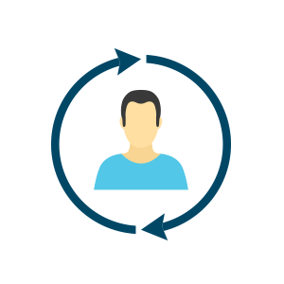


What do citizens want?
Empowerment
Personalisation & Prevention
Convenience
Control access to my own health record
Get advice on how to manage my health risk
Calculate my personal health risk over time
Help me to avoid exacerbations or deterioration
Allow me to message my care team remotely
Allow me to easily navigate to patient networks
Contribute new information to my health record
Let me update my personal information
Support me with educational info when I need it
Let me visualise my health data (e.g. lab results)
Allow me to transact with the system remotely
Allow me to connect on mobile & tablet
Demonstrate empathy in communications
Let me provide feedback on my experience
Gamify the data collection experience
Notify me of any updates to my health record
Help me to avoid completing repetitive tasks
Chronic disease is ongoing, and warrants proactive, planned, integrated care within a system that patients can navigate.
Patients need to be active partners in managing their condition, rather than passive recipients of care.
A multi-faceted approach needs to be taken where clinicians and non-clinicians from multiple disciplines work closely together.
Chronic disease requires disease prevention strategies targeted at the whole population and especially at those at risk.
Notes:
What do people want from improved digital engagement. These learnings are from Orion’s experience in Canterbury NZ however they chime with our experience of numerous discussion and stakeholder engagements.
Looking at the sorts of things we need to consider from chronic disease management perspective, there is an emphasis on the need for patients to be active partners in managing their condition – digital engagement is one way to advance this.
People are living for longer, with healthcare complexity associated with multiple long term conditions, including frailty • For those 75+, emergency admissions have increased by 31% over the past decade • TECS has a role to play in reducing avoidable hospital admissions and enabling people to manage their own health in their own environment

Slide 3
What the system wants
Empowerment
Personalisation & Prevention
Outcomes & Access
Patients & clients as active partners in care
Increased knowledge of their conditions
Increased focus on high risk patients & clients
Release capacity
Improved clinical outcomes
Focus on those who need to be seen most
People signposted to use most appropriate service
Increased knowledge of system
Reduction in exacerbations in chronic disease
Improved engagement & adherence
Reduced DNAs
Holistic overview of relevant information
Patient quality assurance leading to improved safety
Feedback on patient’s & client’s experiences
Improve population health & wellbeing
Increased patient & client satisfaction
Notes:
What do we as a system want from improved citizen engagement and what role could digital play in this
Have swapped out ‘convenience’ for ‘outcomes & access’
Partners, Knowledge, Signposting
Focus on high risk patients and Improved engagement & adherence
Barriers to telehealth take up Poor integration Structural instability Mixed evidence Cultural resistance Accessibility and awareness Lack of resources Poor incentives

Slide 4

So how are we going to make this a reality?
Establish Support the Person portfolio and board
Proactive Care
Informed and supported citizens
Develop a new multi-disciplinary approach to Service Design
HSC Professionals supported in providing care right time, right place
More efficient and effective service provision
Co-create a new Support the Person strategy across the HSC
Deliver new services, that scale and are sustainable, quickly
Notes:
Reminder of eHealth & Care strategy objective
Outcomes that we are trying to achieve through work in this area
What we need to do to progress work and begin to achieve these outcomes

Slide 5

THE ROLE OF DATA | reactive to proactive to predictive healthcare
Predictive healthcare systems predict risk and intervene further upstream leveraging cutting-edge technologies and sophisticated machine learning data algorithms.
Reactive healthcare systems wait for patients to notice symptoms and for the patients to contact the system to diagnose and treat illness.
Proactive healthcare systems stratify at-risk individuals based on known risk factors and ensure that preventive action is taken to intervene well before the onset of symptoms, let alone illness.
Predictive
Reactive
Proactive
DELIVERY CRITERIA | how we can accelerate delivery
AGILE - choose or build low cost solutions with proven high value, deliver MVP and iterate quickly
1
2
HIGHLY FLEXIBLE - avoid disease or setting specific solutions, have view of wider applications
3
EASY TO USE - no obstacles to adoption for patients, clients, carers & staff
4
DEMAND REDUCING / STREAMING - constant checking back against the mission
5
INTEROPERABILITY - standards based solutions, enforced
Notes:
As a system wish to move from Reactive to Proactive and Predictive strategies – not easy to achieve. Data and use of digital engagement has important role to play
And we need to think about the principles or delivery criteria that we should adopt in approaching this agenda

Slide 6

LINKING THE STRATEGY | wider transformation agenda
Diabetes, child health and other service frameworks & networks
Review of Urgent & Emergency Care
Review of Adult Social Care & Domiciliary Care
Multi-Disciplinary Teams
Frailty
NHSCT Prototype
Acute Care at Home
Neighbourhood Nursing
Making Life Better & Community Planning Partnerships
Nursing Home Collaborative & Prison Healthcare
Notes:
Digital engagement is not a tail wagging a dog
Rather is and needs to be an intrinsic part of delivering the broader transformation agenda
Presents both challenges and opportunities in terms of the approach to design and stakeholder engagement

Slide 7
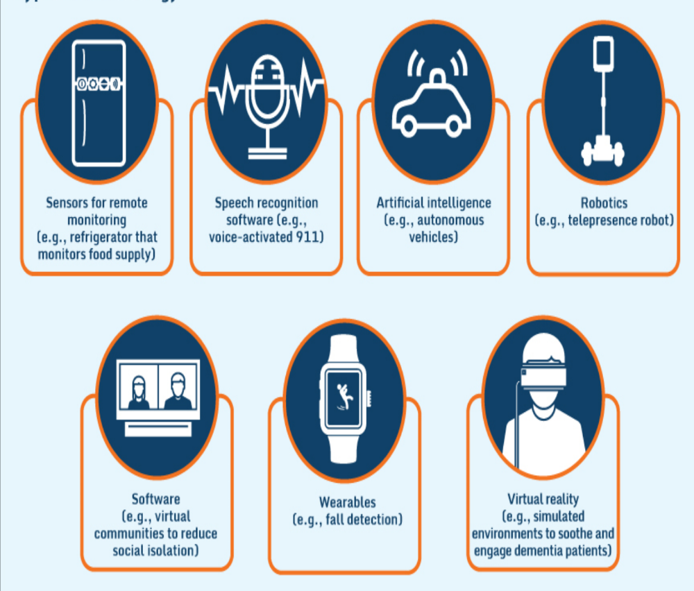
What do we mean by digital health?

Slide 8


Dimensions of frailty and ways of working…
Food and nutrition;
Physical activity;
Frailty and functional decline;
Cognitive function;
Caregivers.
Workforce
Models of Care
Notes:
Realising that a combination of factors can move individuals from low to immediate high risk very quickly

Slide 9
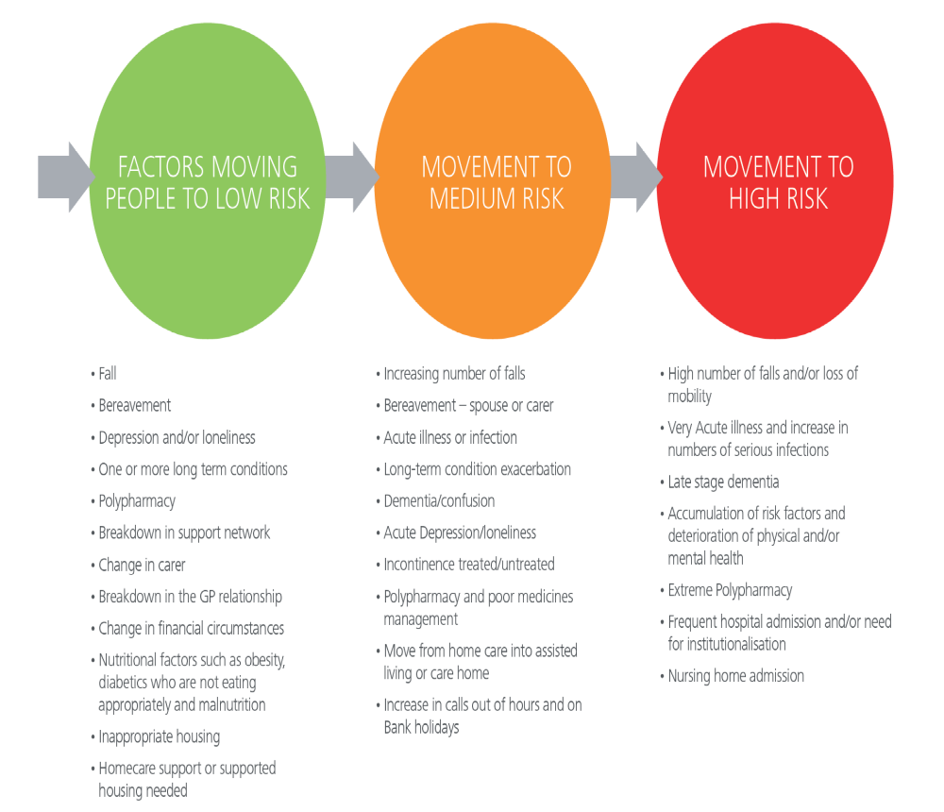
Notes:
Improve interoperability of information
Information prescriptions
TEC

Slide 10
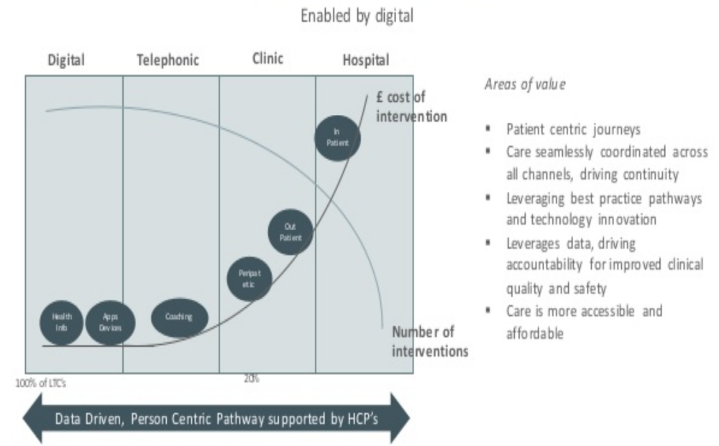

Slide 11
My Care Record Patient Portal
Integrated within NIECR
Appointments
Goal Setting & Monitoring
Circle of Care
Documents
Forms
Questionnaires
Educational Materials
Lab Results
Messaging
Vital sign monitoring & Coaching
Virtual Consultations
Flo simple telehealth & Inhealthcare
Use of VC
Remote triage care & advice
Digital Supports
HSC on-line
Directory of Services
Social Prescribing
Apps Library
On-line User Feedback
Citizen digital identity
Telecare
Alarms & sensors to give rise to an emergency situation
Mainstreamed application for upstream support & reduction in care packages
Better use of data
Potential for ‘lower level’ outward bound support
Smart Homes & Electronic Assistive Technology
Opportunity to facilitate more independent living
Notes:
Some really strong functionality already available which we need to tie together and promote better as part & parcel of what trying to achieve
Portal – developed as part of the DSC dementia eHealth initiative has very rich functionality which will benefit patients, clients and the service and lay the ground well for encompass

Slide 12












View Documents
Produce and manage Patient care documentation
Monitoring Plan
Cohort or patient specific monitoring plan including medication management
Lab Results
View Lab results in a consumer friendly format
Circle of Care
Family and friends can care for others by being part of their circle of care
My Data and Goals
Track progress observations, diagnosis and problems towards personalised health goals
Shared Files
Upload documents, photos and videos for clinicians and patients to view
Patient Engagement
Appointments
View upcoming appointments and receive email reminders
Health Library
Provide patient-centric health resources to consumers
Notifications
Receive email notifications for any changes to your patient health records
Communicate
Secure video communication between patients and care team
EXAMPLE 1 | citizen engagement through My Care Record
Notes:
These are the components that can be found within the Patient Portal, some of which (circle of care, and goals & observations) can also be found on the Engage Mobile app.
The Patient Portal is accredited under the Meaningful Use stage 2 incentive program in the U.S. MU2 compliance requires Patient specific education resources and the ability of the patient to view, download and transmit documents to third parties.

Slide 13
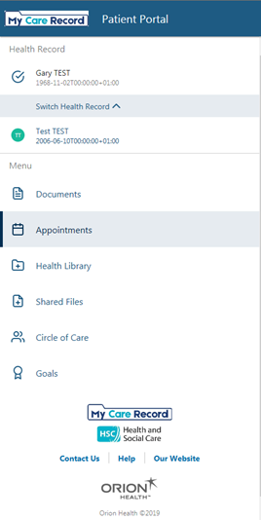
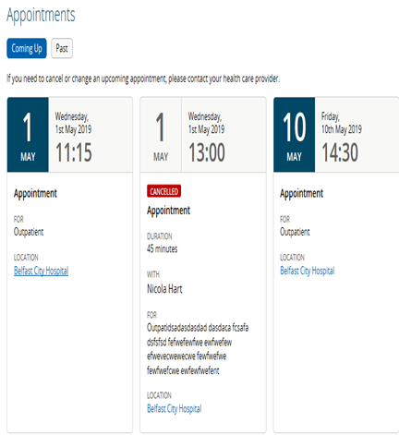
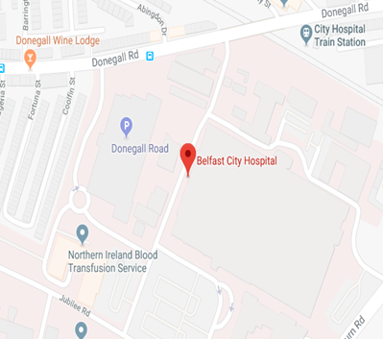
My Care Record

Slide 14
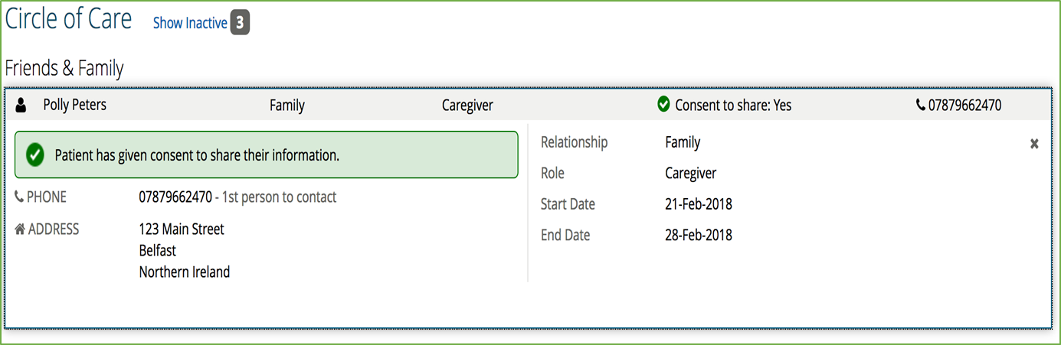
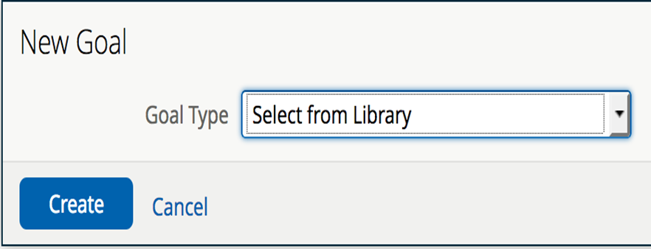
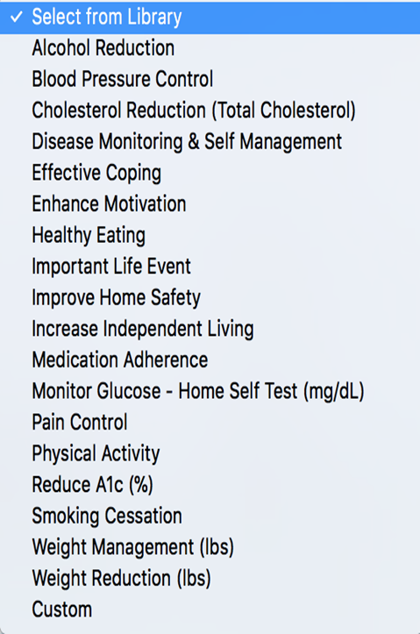
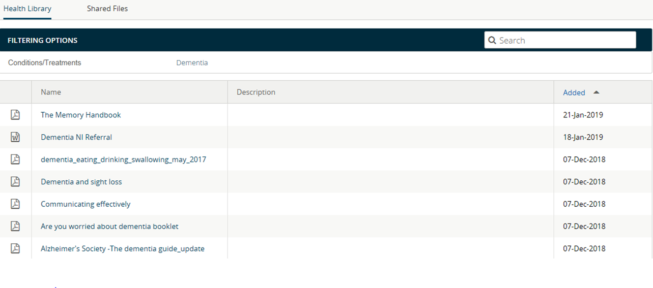

Slide 15
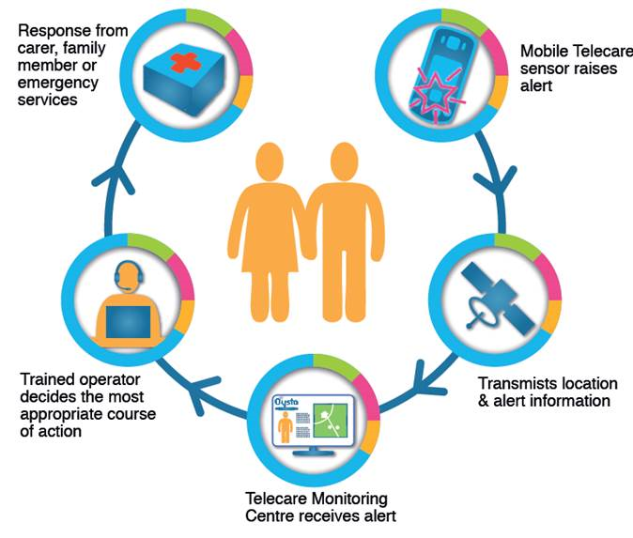
Telecare

Slide 16
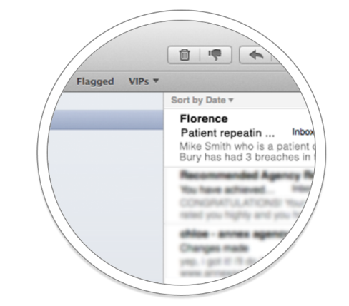
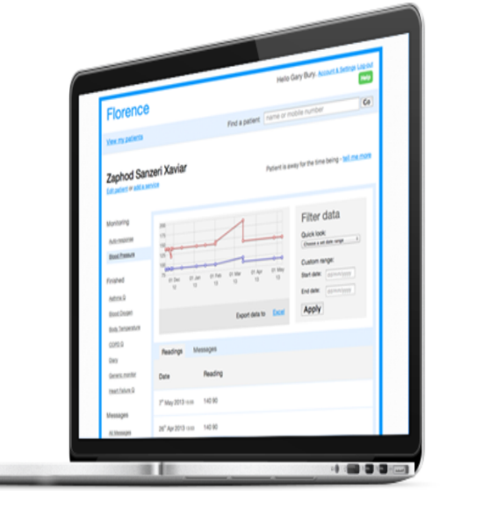
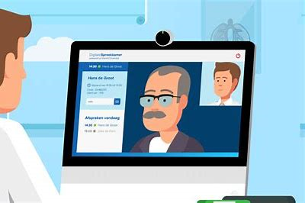
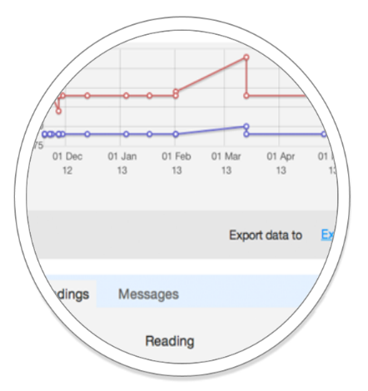
Virtual consultation
Messaging +
electronic communications to improve a patient’s health
self care & management
reminders
Notes:
Flo is a text messaging system that sends patients reminders and health tips tailored to their individual needs.

Slide 17
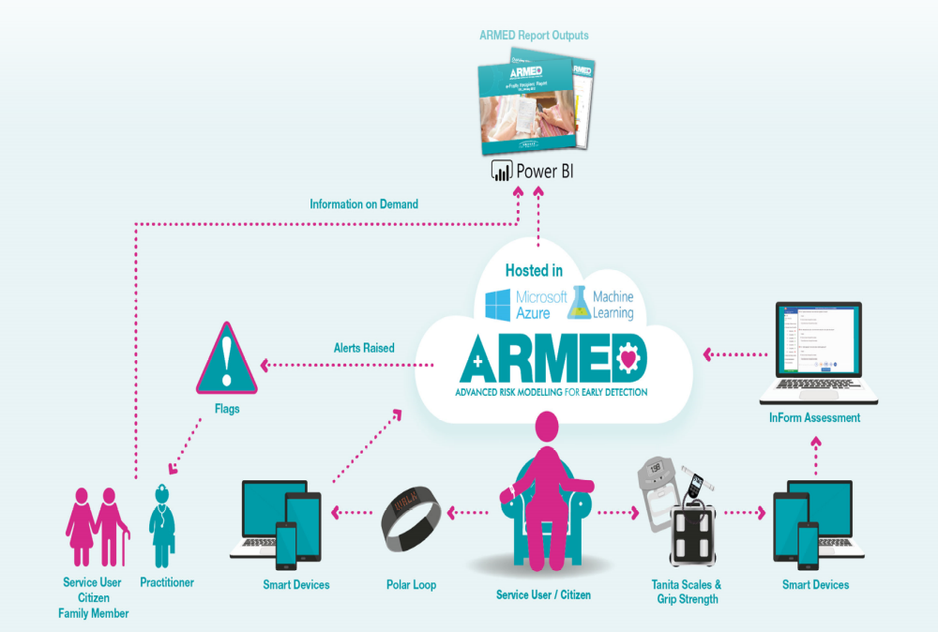
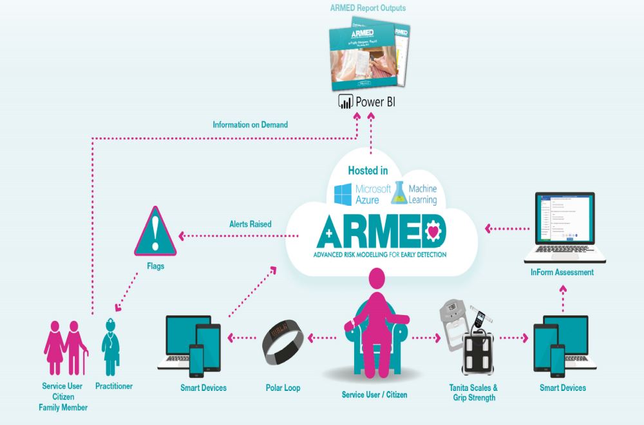
Falls prevention

Slide 18
Apps for Dementia
The apps4dementia library provides a place for users to :
find safe, trusted apps for information and guidance on the condition, support self-care of symptoms and enable users to carry on with their day-to-day activities for as long as possible
find a range of applications which have been independently checked and reviewed for data privacy, clinical assurance and user experience

Slide 19
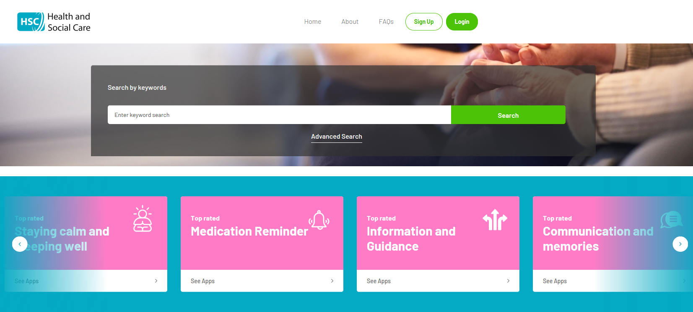
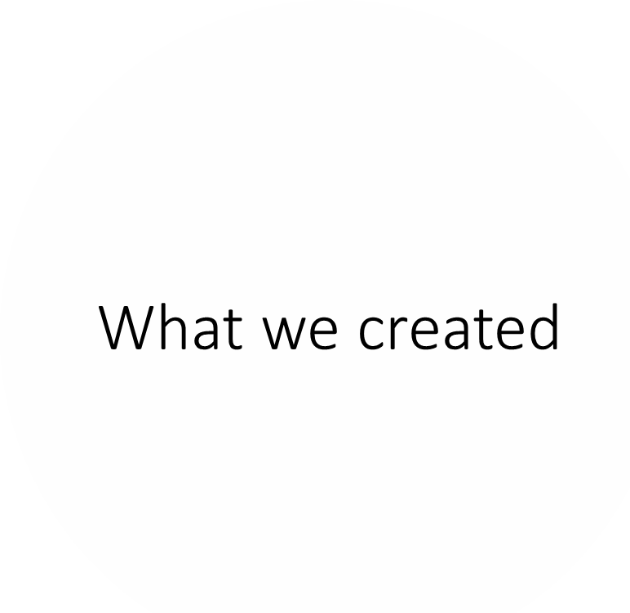
https://apps4dementia.orcha.co.uk

Slide 20
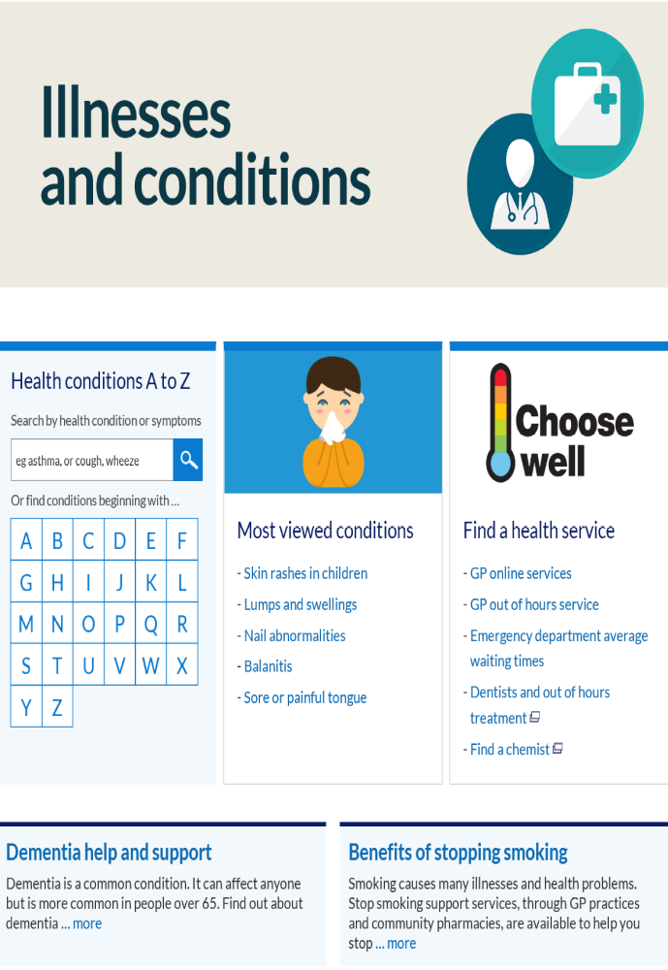
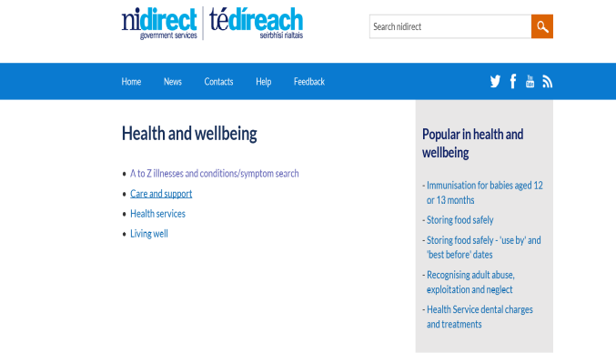
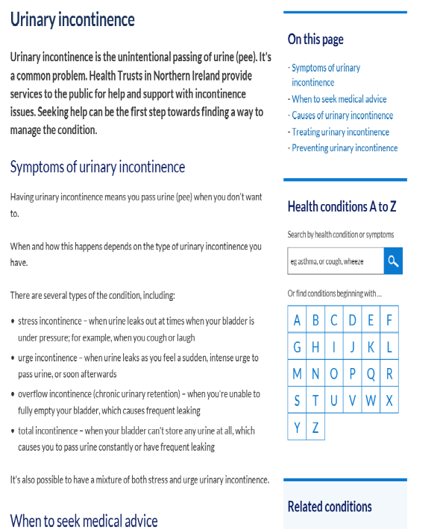
Digital Support

