Slide 1

WHO ICOPE
Integrated Care for Older People
Four Principles
Older people are afforded the same basic human rights as all people, including the right to the best possible health.
Older people should be given equal opportunity to achieve healthy ageing, regardless of social or economic status, place of birth or residence, or other social factors.
Care should be provided with equality and non-discrimination, particularly on gender, age and ethnicity.
Health and social care systems and services need to respond to the unique health and social care needs and goals of older people, which may vary over time, and should address the social determinants of health.
https://www.who.int/ageing/health-systems/icope/en/

Slide 2
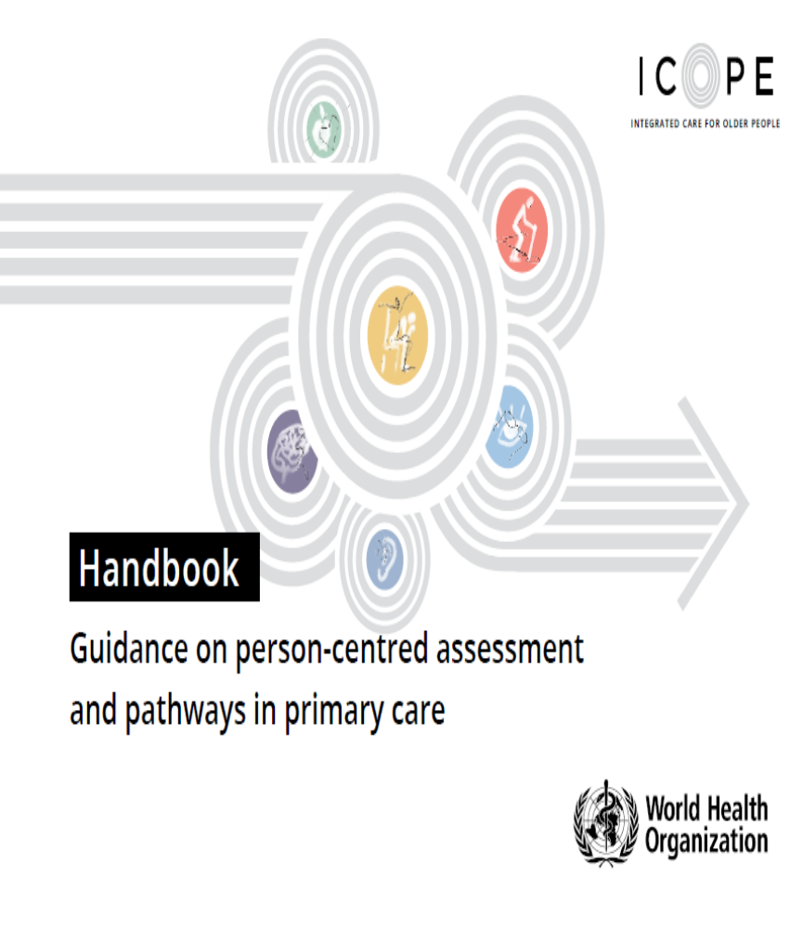
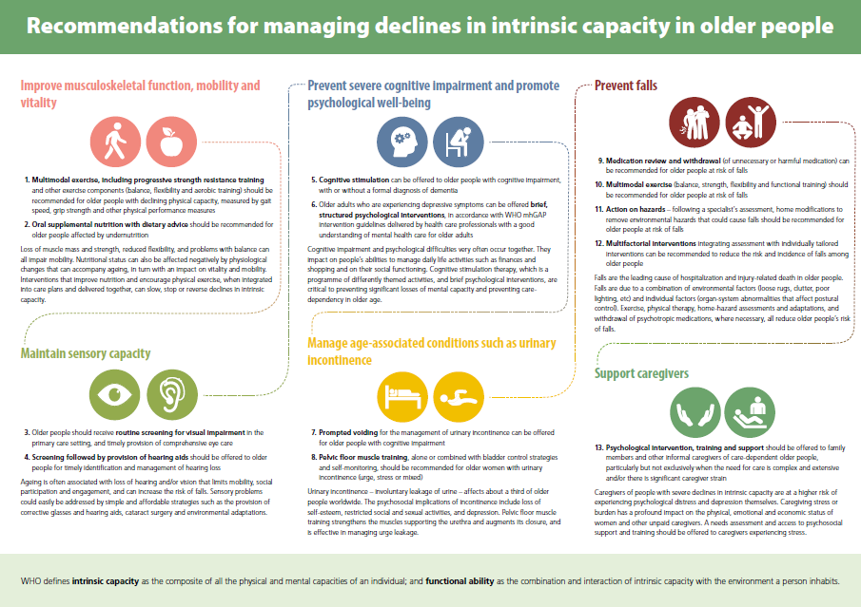
Person Centred assessment and pathways in primary care

Slide 3
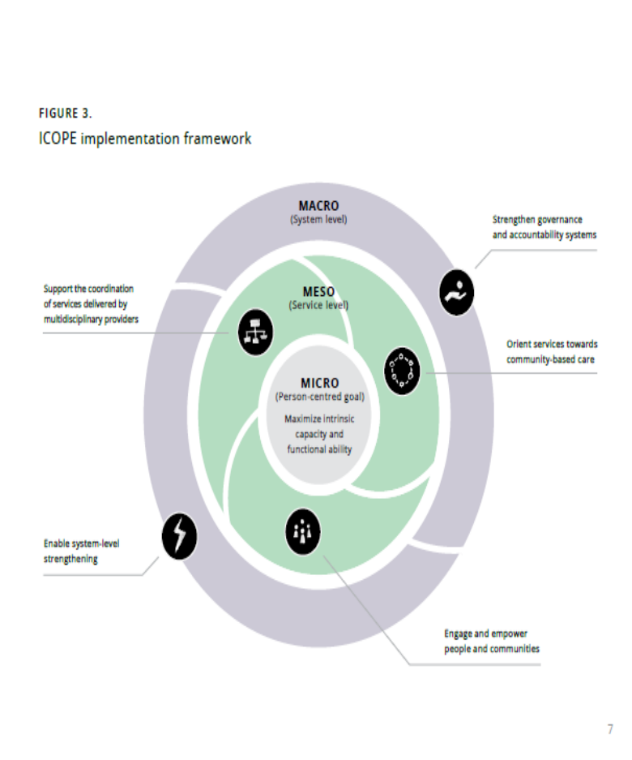

ICOPE Implementation Framework and Scorecard

Slide 4
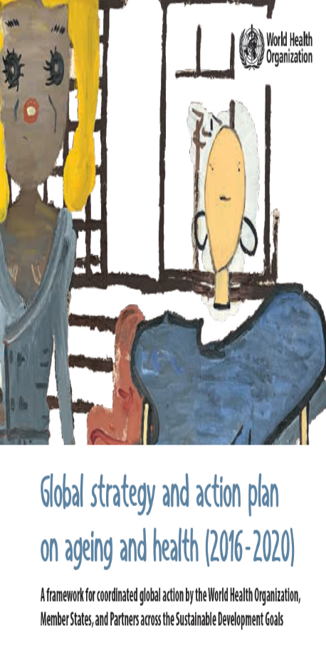
WHO Global Strategy and Plan of Action on
Ageing and Health
Five Strategic Objectives
1. Commitment to action on Healthy Ageing in every country
2. Developing age-friendly environments
3. Aligning health systems to the needs of older populations
4. Sustainable and equitable systems for long-term care (home, communities, institutions)
5. Improving measurement, monitoring and research on Healthy Ageing
2016 – 2020
Evidence-based action to maximize functional ability every person.
Build readiness, evidence and partnerships for a Decade of Healthy Ageing

Slide 5

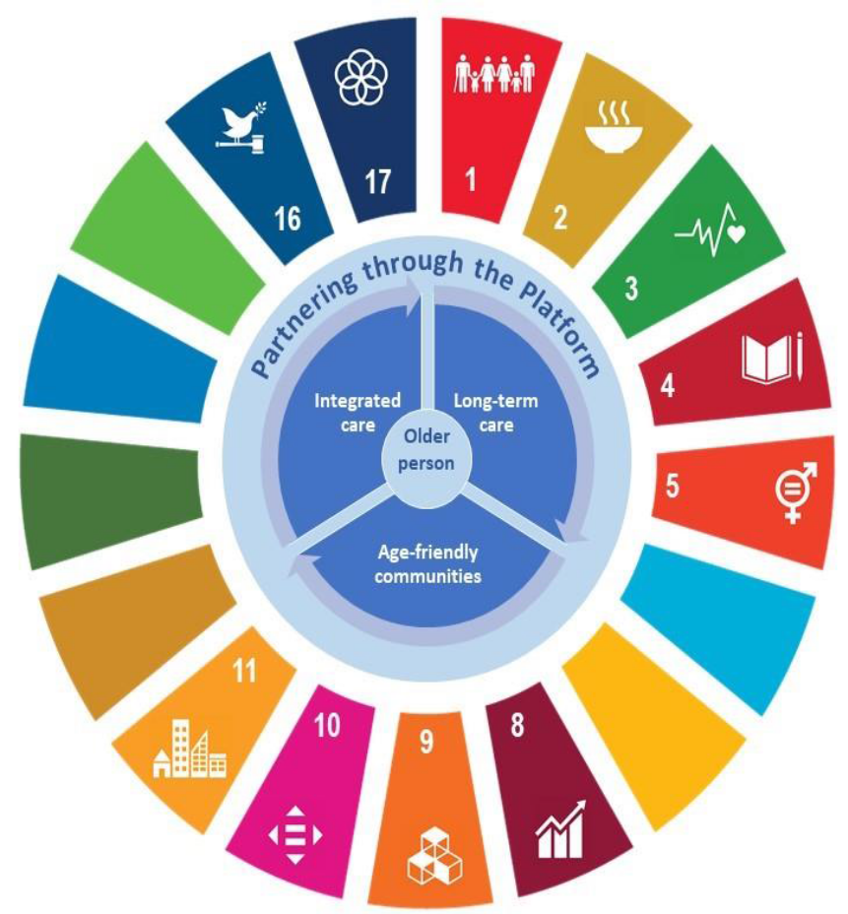
Key Action Areas
Develop age friendly communities
Ensure person centred integrated care for older people
Provide older people who need it access to long-term care within their communities
https://www.who.int/ageing/decade-of-healthy-ageing

Slide 6




Knowledge Exchange
Webinar Series and Topic Resources
www.integratedcarefoundation.org/scotland
Special Interest Groups (SIGs) hosted on IFIC website:
  Polypharmacy and Adherence
  Intermediate Care
  Palliative & End of Life Care
  Self Management and Co-production
  Compassionate Communities Small Island Systems
  Frailty
Sign up at: https://integratedcarefoundation.org/ific-membersnetwork/groups/
  Marie Curran IFICscotland@integratedcarefoundation.org

Slide 7
Thank you
anne.hendry@lanarkshire.scot.nhs.uk
  IFICscotland@integratedcarefoundation.org
  www.advantageja.eu

Slide 8


NI Frailty Network
Working with older people to Identify What Matters
Paschal McKeown
Age NI Charity Director
1 October 2019

Slide 9
Rethinking frailty: what really matters
An ageing society
Frailty matters to older people
Engaging with older people
ExpertAge
Views on frailty
Notes:
Lots of older people lead fulfilling lives, contributing to the economy and the life of their local community through volunteering, by continuing to work and pay taxes, and by caring for others such as grandchildren, partners, friends and neighbours. Some older people tell us, however, that they struggle on their income and feel lonely and isolated.
We can all play our part by doing what we can to stay as well as possible: keeping active, eating well, being a good neighbour, maintaining our social networks and friendships; financially preparing for our own futures; and by challenging ageist assumptions about older people and ageing.

Slide 10

Challenges
Terminology & definitions
Identification & prevention
Support

Slide 11
Co-production: what works
Why it matters
Participation, involvement, engagement
DoH guide
- 6 principles

Slide 12
What works
Planning
Resources
Mobilisation
Motivation
Relationships

Slide 13
Coproducing the logo
Anne Murray
Our approach
What we did
Successful outcome

Slide 14


Slide 15
Personal perspective
Emily Gill
A personal experience of frailty

Slide 16



LUNCH & NETWORKING
1.45pm - MASTERCLASS SESSIONS
WJ Mayes Hall – Dr Roman Romero-Ortuno
Lakeview 1 – Consultant Pharmacists
Lakeview 2 – Expert Age
#NIFrailtyNetwork
E: frailtynetwork@hscni.net

Slide 17

Closing Remarks
Mr Robert Ferguson

Slide 18
Thank you for attending today
Remember
Frailty is everybody’s business
Join the Frailty Network at frailtynetwork@hscni.net

