Slide 2
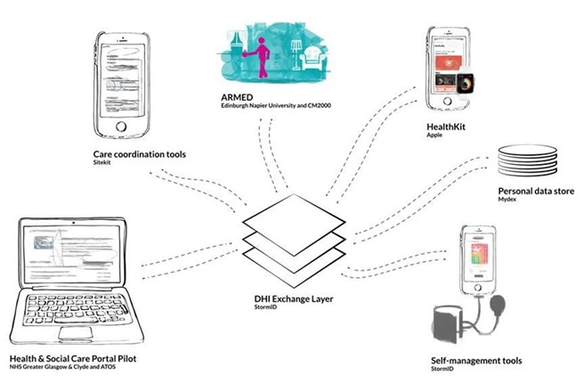

Final thoughts
Think digital
Improve the interoperability of information to enable
Identification of risk
Integrated care pathways
Multi professional teams
Cross sector working
But importantly the
Quality, safety and experience of those with frailty
Notes:
Further work needs to be carried out to reduce the gap existing between technology, frail elderly persons, healthcare professionals and carers to bring together the different views about technology.
Recommendations for policy makers to increase deployment Re-establishing the case for telehealth • Best practice and evidence review Raising awareness • National awareness programme and patient empowerment campaign • A personal technology czar Funding mechanisms • Aligned incentives, integration • Pooled budgets, top sliced funding • Outcome based commissioning System transformation • National implementation team • National training programme • Redesigned pathways • GP incentives

Slide 4


COMFORT BREAK

Slide 5
Improving Outcomes:
European Frailty Prevention Approach
Prof Anne Hendry
UK Lead, Advantage JA

Slide 6
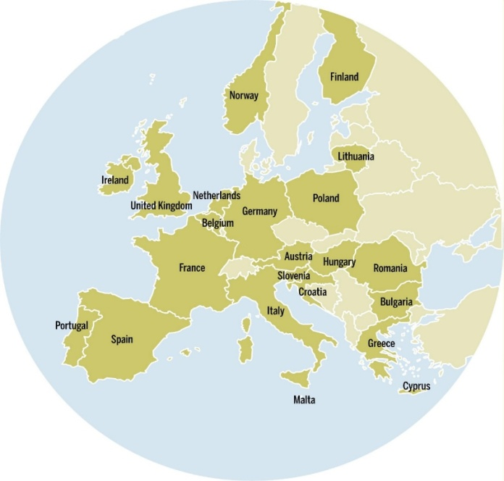
ADVANTAGE JA
“A comprehensive approach to promote a disability-free Advanced age in Europe: the ADVANTAGE initiative”
The number of people 65+ is predicted to rise from 18% to 28% by 2060
12% of the population will be aged 80+
Policy Joint Action with 22 Member States and 33 organisations
Co-funded by the EU and the Member States.
January 2017 - December 2019 (3 years)
COORDINATOR: Hospital de Getafe SERMAS, Madrid Spain
UK Lead – Scottish Government / NHS Lanarkshire
www.advantageja.eu

Slide 7


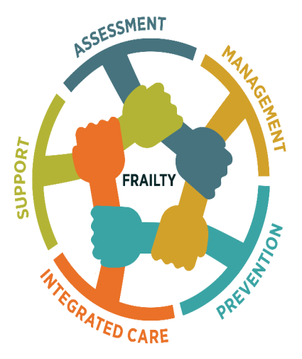

Implementation
Phase I (2017) - State of the Art - background information collection, analysis, rational discussion and drafting of preliminary documents.
Phase II (2018) – Survey of MS status on frailty, developing and testing draft version of common European model to approach frailty (frailty prevention approach – FPA document).
Phase III (2019) - drafting final documents, debating these with participant MSs, and drafting the final framework (FPA document and policy recommendations).

Slide 8

Advantage JA #faceuptofrailty

Slide 9
Preventing Frailty
Start active ageing recommendations at mid life
Asses risk for malnutrition using the Mini Nutritional Assessment
Promote a Mediterranean diet /daily protein >1-1.2 g per kg
Target BMI < 30
Low intensity exercise (endurance, ﬂexibility, balance, resistance training) in sessions of 30 to 45 minutes, three times per week.
Vitamin D supplement if increased risk for falls / fracture

Slide 10
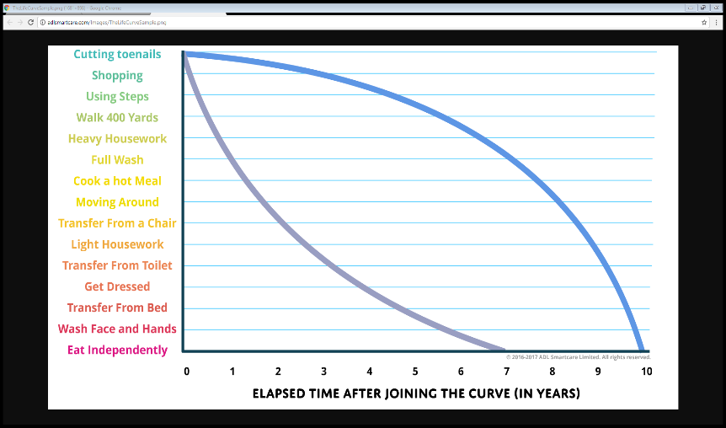
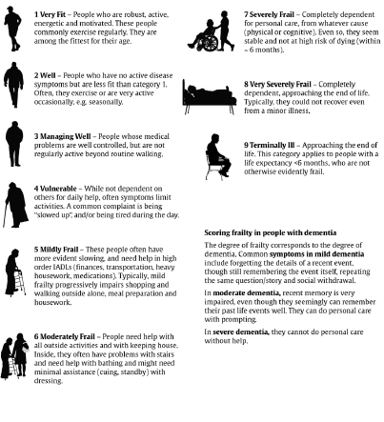
Identifying Frailty
Opportunistic screening in patients over 70 years using tools that are:
Quick to administer (taking no more than 10 minutes to complete).
Do not require special equipment.
Have been validated and are meant for screening

Slide 11
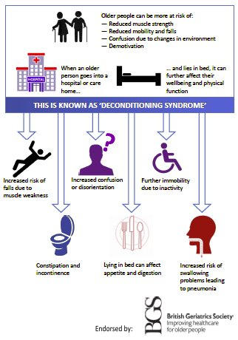
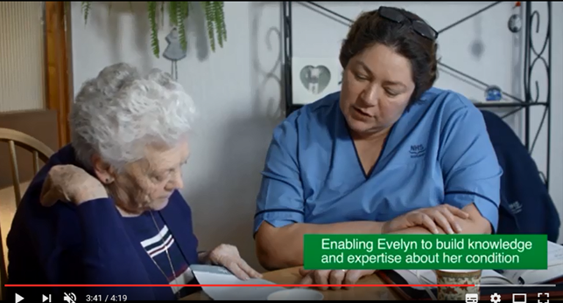

Managing Frailty
Comprehensive Geriatric Assessment
Care planning and tailored MDT interventions
Telehealth and telecare solutions
Falls prevention and nutrition interventions
Tools to reduce inappropriate polypharmacy

Slide 12
Integrated Care for Frailty
a single entry point – generally in Primary Care
simple frailty screening tools in all settings
comprehensive assessment and individualised care plans – including for carers
tailored interventions by interdisciplinary team – both at home and in hospital
case management and coordination of care and support across providers
effective management of transitions between teams and settings
shared electronic information tools and technology enabled care
clear policies and procedures for service eligibility and processes.
Hendry, A, et al. Integrated Care: A Collaborative ADVANTAGE for Frailty. International Journal of Integrated Care, 2018; 18(2): 1, 1–4. DOI: https://doi.org/10.5334/ijic.4156

Slide 13
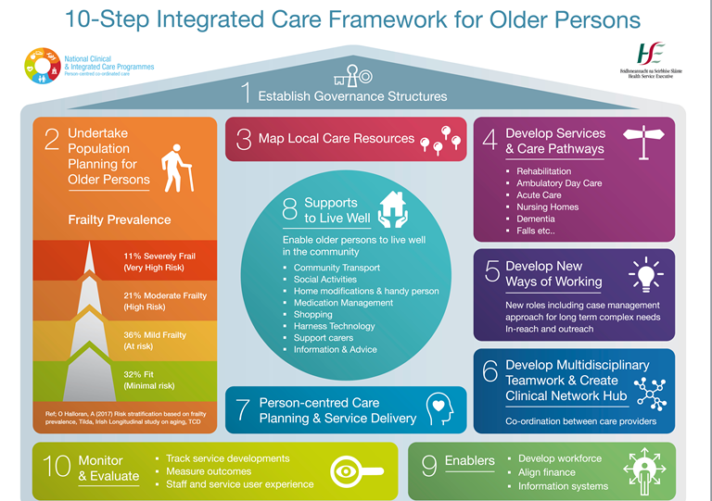
Models of Integrated Care

Slide 14

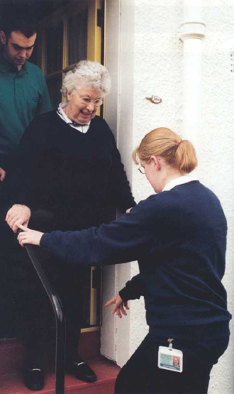
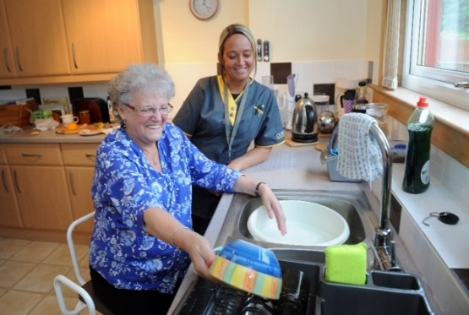
Transitional and Intermediate Care
Transitional Care Services
Rapid Response / Supported Discharge
Reablement home care
Step Up / Step Down community beds
Hospital at Home

Slide 15
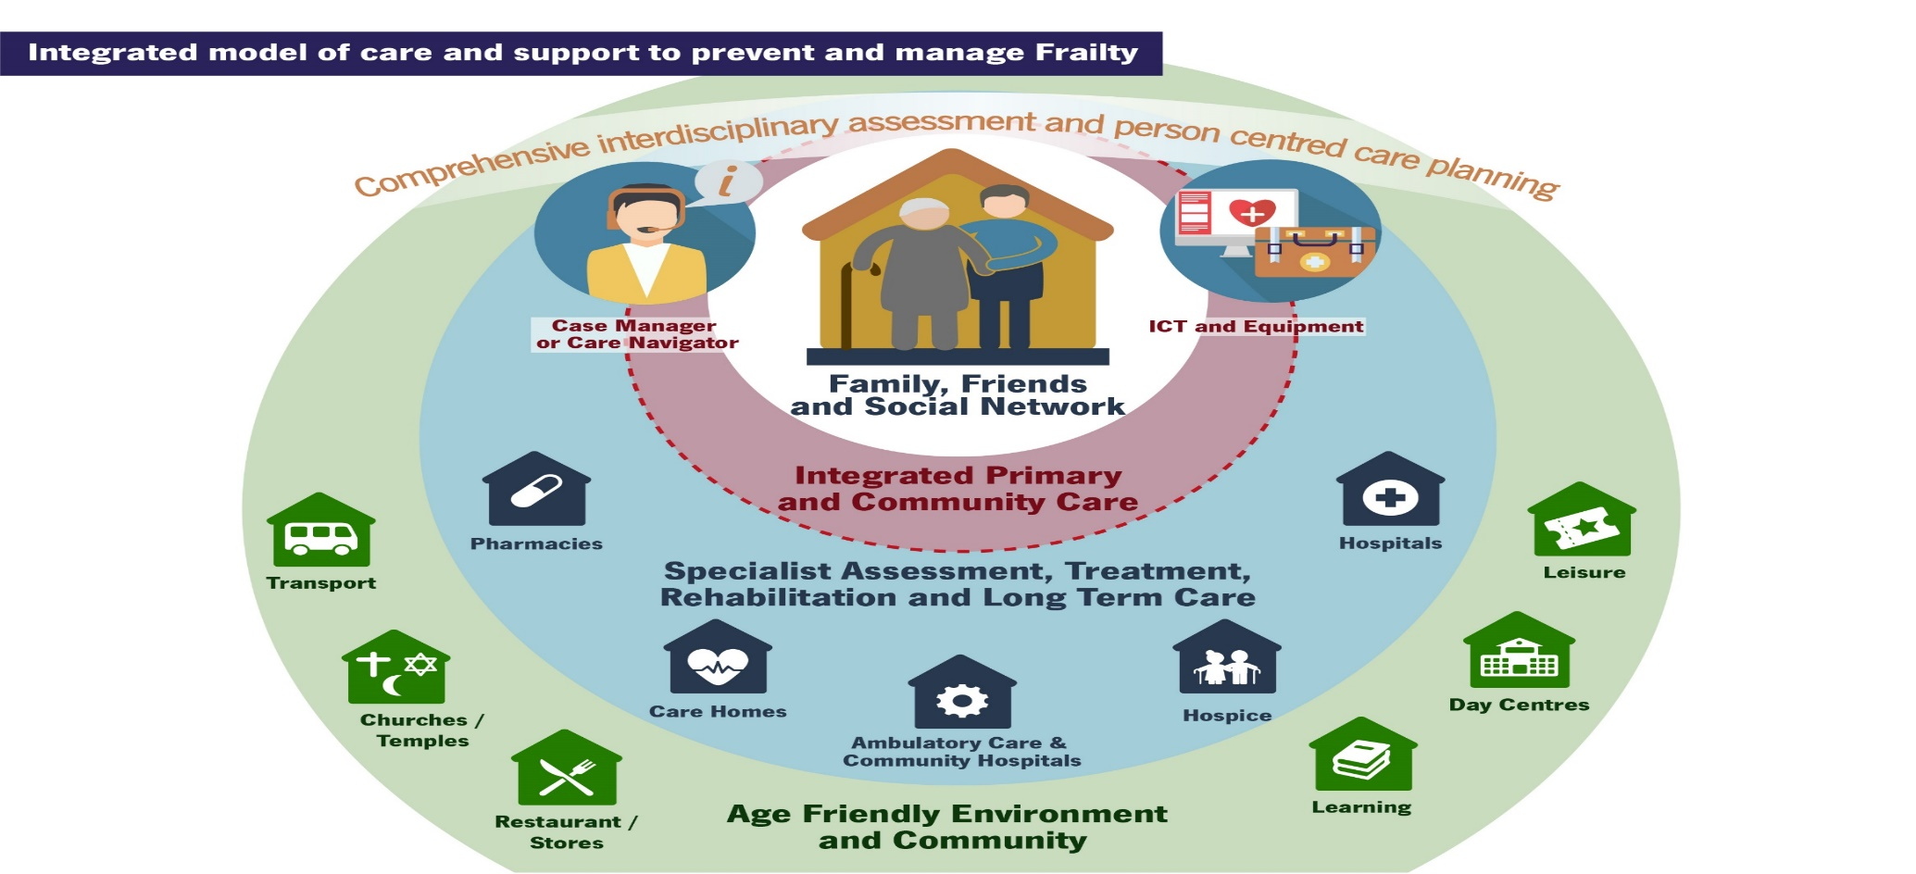
Frailty Prevention Approach

