Slide 1
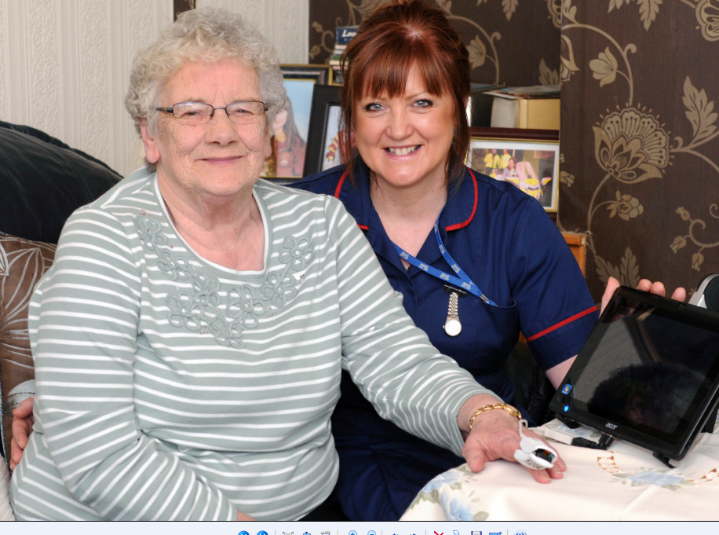

Education on Frailty
“My care is planned with people who work together to understand me and my carer(s), put me in control, coordinate and deliver services to achieve my best outcomes” National Voices
Coordination and continuity of care
Trusted relationships
Accessible information and advice
Good communication with, and between, staff
NHS England, Skills for Health and Health Education England

Slide 2
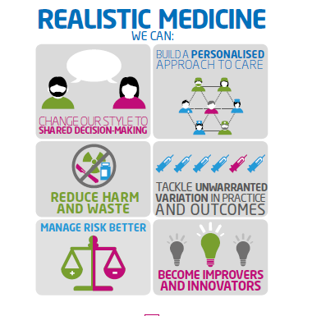
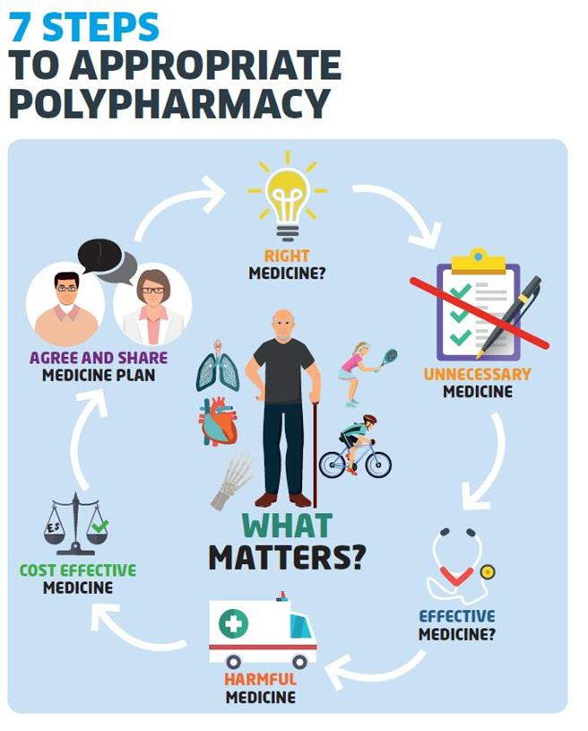
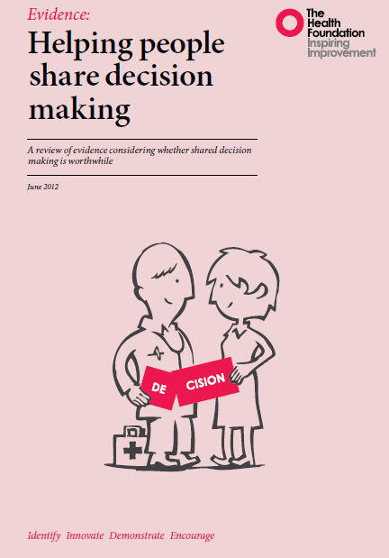
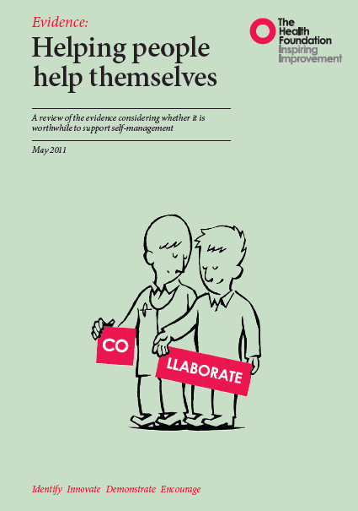
Collaborative Care Planning
www.therapeutics.scot.nhs.uk/polypharmacy

Slide 3
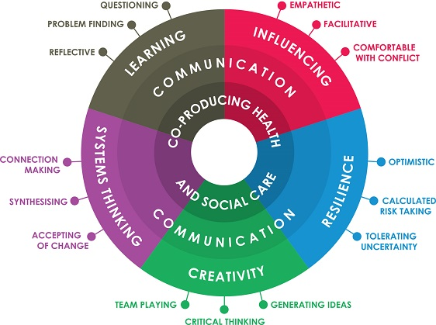
Workforce Development
Lucas and Nacer (2015) https://www.health.org.uk/sites/default/files/TheHabitsOfAnImprover.pdf
NHS Right Care

Slide 4
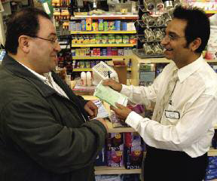
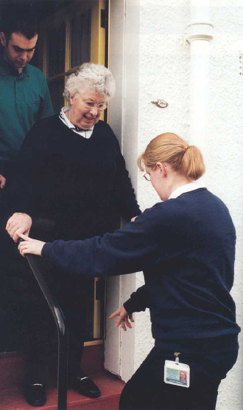


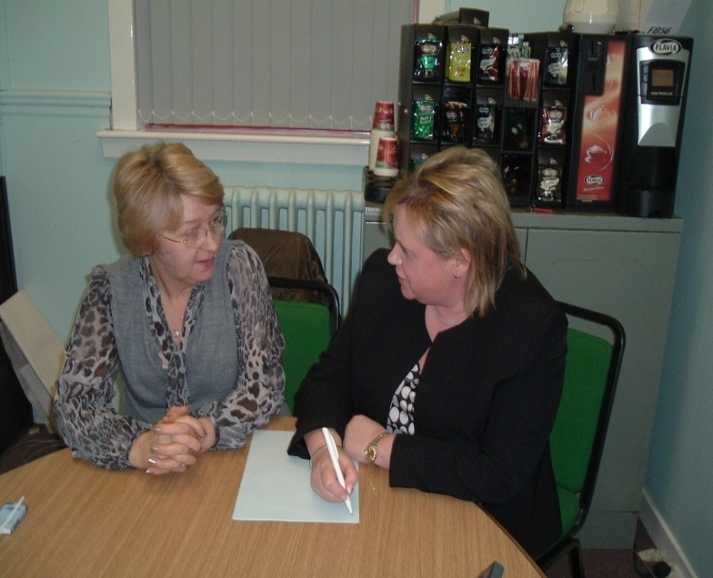
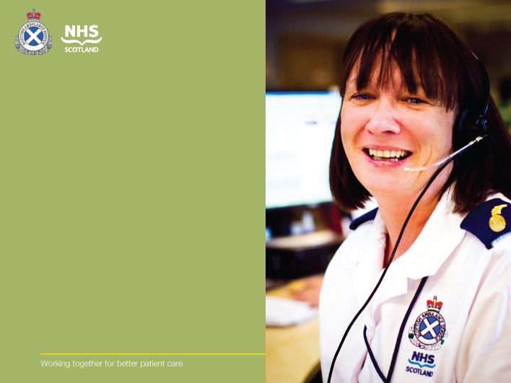
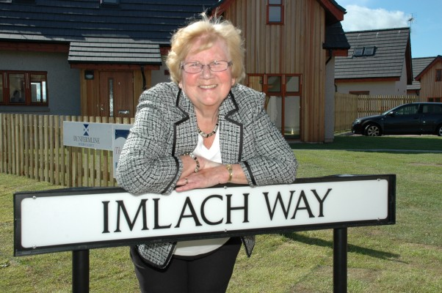

Technology Enabled Interdisciplinary Networks of Care and Support
Notes:
4
4

Slide 5
Neighbourhood Relationships
Public Health England 2019

Slide 6


Compassionate Communities
https://ardgowanhospice.org.uk/how-we-can-help/compassionate-inverclyde/
“ A Compassionate community is a community where everybody recognises that we all have a role to play in supporting each other in times of crisis and loss. People are ready, willing and confident to have conversations about living and dying well and to support each other in an emotional and practical ways”

