Slide 1
Acute Frailty services
Southern trust
Gail Nicholson /Rebecca Teggart
FIT/H@H team
Southern Trust

Slide 2
Aims
Southern Trust FIT / H@H service
AHP experience
Patient experience
Challenges we have encountered
Lessons in Frailty service development

Slide 3
What does a good service look like for an older person ?
Proactive, holistic, and person centred
Comprehensive Geriatric Assessment
Proactive care planning
Person centred approach
Integrated and coordinated care
Access to specialised services
Promoting Active Aging
Technology integration

Slide 4
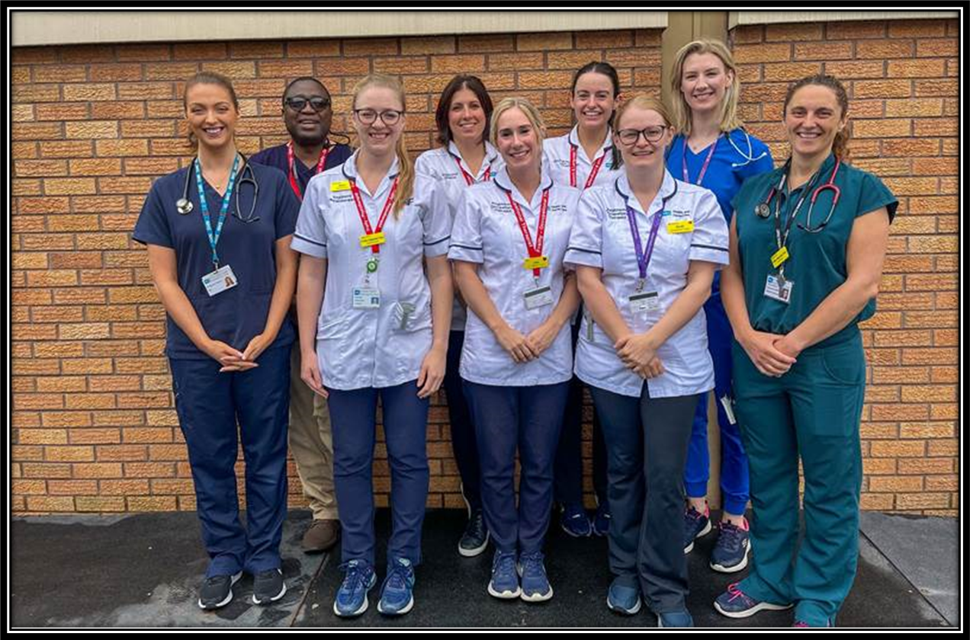
Frailty Intervention Team (FIT)
Craigavon Area Hospital – Emergency Department

Slide 5
Pre FIT Pathway
ED presentation
ED assessment
MDT referral initiated by ED staff
Discharged /admitted
Criteria for admission to COE – age based
Several days / ward moves before base ward

Slide 6
FIT Pathway
Hours of Operation M-F 8am-5pm-weekend review /screening
ED Proactive screening in AM
Initiation of reactive CGA as close to front door as possible
Assume responsibility for patient
Clear communication within the team
Clear pathways from ED using existing pathway
Trialling designated space ( 8 beds )

Slide 7
FIT Criteria
Inclusion
>65 years
CFS 5 or above
Presenting with a Frailty syndrome
Living in a Care home –RH/NH
Exclusion
Major trauma / stroke/ chest pain
Requiring active resus
Requiring specialist team input

Slide 8
FIT team staffing
Discipline | Staffing August 2025
Medical | 2 wte Consultant 1 registrar 1 speciality doctor 2 locum medical staff
Nursing | 1 wte Nurse (from AFU)
Physio | 1 wte
OT | 1 wte
SALT | 0.5 wte
Dietician | 0.5wte
Pharmacy | 1WTE ( not filled Aug 2025)
Admin support | 0.5 WTE

Slide 9
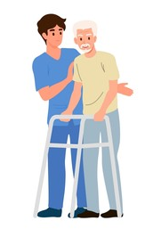

Physiotherapy +
Occupational Therapy
Referral and triage
Assessment
Treatment
Onward referrals and Discharge

Slide 10

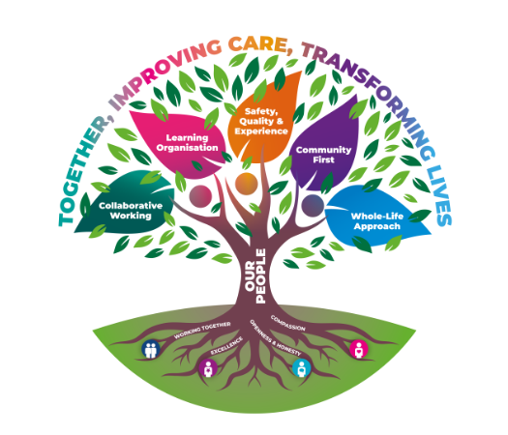
Speech and Language Therapy
55% of Frail Adults will report difficulties with their swallowing (Dysphagia) Smithard et al., 2020
Communication difficulties may also arise from or co-occur with Frailty
Previous Context
No dedicated SLT service in ED
Historically Low referral numbers to Core SLT service from ED
Poor identification of dysphagia
Average waiting time June 2023 for ED referrals for core SLT Service assessment -> 4.6 DAYS
Under-reporting of dysphagia-related incidents
Current Frailty SLT Service
0.5 wte SLT in Frailty Service in ED (2.5days)
346 referrals to Frailty SLT since pilot started (Nov 2024)
231 Seen by SLT
170 SLT fit- for same day discharge
95 Unseen
Average ED waiting time for Frailty SLT assessment June 2025: 1.9 HOURS
25% of ED Nurses have attended F2F dysphagia awareness training
Impact of Frailty
SLT Service
415% increase in referrals
Discharges facilitated
Length of stay/bed days reduced
Preventing/reducing swallow deconditioning
Enhanced patient safety, comfort & quality of life
Patient and family satisfaction
Notes:
Dysphagia is a common consequence of frailty in older adults and communication difficulties can also arise.
BOX 1
Prior to Winter 2023 when our frailty projects started - There was no dedicated SLT service within ED.
Any ED patients deemed as needing SLT input at that time – were made to the core SLT service, where referrals assigned a priority alongside the wider SLT hospital referrals received, then added to a waiting list for assessment.
Increased number of bed days were incurred while patients were waiting for assessment – number of which varied depending on SLT clinical prioritisation of patients waiting.
Referral data would suggest low referral numbers to SLT; challenging waiting times by core Service and that ED staff struggled to identify and refer appropriate patients who required SLT input.
Now with a Frailty SLT present in ED, the development of SLT Frailty Referral Criteria/Guidance and ED staff engagement with Dysphagia Awareness training - SLT Frailty Referral numbers have notably and appropriately increased. Just by way of example, an isolated monthly comparison of June 2023 –> 7 ED referrals made to core SLT service versus June 2025 –> when 36 ED referrals were received by the Frailty SLT in ED.
Datix data suggests under –reporting of dysphagia related incidents in ED for example incorrect textures of foods or fluids given (in time frame Jan – June 2024 only 1 incident compared to 14 dysphagia-related Datix from Jan - June 2025. This facilitated shared learning and relevant, targeted training to be provided.
BOX 2
Current SLT provision in ED within the Frailty team
Part time post allows 2.5 days of a dedicated SLT service
346 referrals to SLT since this pilot started in mid-Nov 2024
231 of these seen by SLT and 170 of these considered SLT fit for same day discharge
Unmet need of 115 which reflects the part time hours of the post.
Response time on SLT working days was 1.9 hours so a significant decrease in waiting time compared to pre- Frailty project.
Staff Training delivered in partnership with Dysphagia Support Team: 25% of ED nursing staff have now attended F2F dysphagia awareness training. We are delighted with progress so far and more sessions are planned – content included: recognition of dysphagia, making a referral to SLT and how to locating swallowing advice on Encompass.
BOX 3
Impact of SLT within the Frailty Service provision within ED
a 415% / ‘five-fold’ increase in referrals and all staff we surveyed reported increased awareness of dysphagia and how to manage these patients within ED
Discharge facilitated by timely assessment by SLT
Length of Inpatient stay reduced
Preventing or reducing decompensation of swallowing (and overall general deconditioning) - through timely re-instatement of oral nutrition & hydration as appropriate, following SLT intervention including maintaining oral health.
Patient, safety, comfort and quality of life enhanced as eating, drinking and swallowing needs are met by more timely, high-quality SLT intervention. Service user feedback reflects this.
Unmet / Future Needs
More SLT hours within the ED Frailty team would:
help fulfil the unmet patient need.
Support outstanding and ongoing Dysphagia training needs for the remaining 75% of ED nursing staff
Finish :
We are hopeful to secure these key areas of unmet need in the future

Slide 11


Dietetics FIT Team
32% of people >65years are deemed at risk of malnutrition.
Traditional Role of Dietitian in ED
Referrals received and triaged to the inpatient dietetic waiting list. Only the most urgent referrals triaged and assessed in ED e.g. High potassium levels requiring dietary modifications. Enteral feeding (new nasogastric tubes, established community enteral feeds). Complicated diabetes (new Type 1 Diabetes, New insulin start).
Frailty Dietitian Referral Criteria
Weight loss documented or reported. On new dietetic community waiting list awaiting initial assessment. On Oral Nutritional Supplements with no planned dietetic follow-up (e.g. started in hospital previously or by GP). Dysphagia (new or deteriorating). Wound Healing. Constipation. Iron Deficiency Anaemia. Patients with repeated falls. Repeated admission with chest infections.
Up until week ending 19th September 2025 397 referrals received and 334 assessments undertaken.
  Of the 334 dietetic assessments undertaken 100% were carried out on the day of referral.
  68% reduction in the number of patients discharged before seen.

Slide 12
FIT outcomes ( Feb – August 2025)
Numbers seen average 243 patients per month
Average frailty score 6
Average age 81yrs
Source of referrals
35 % discharged at D0 – (595 patients)
45% of D0 discharges ( 270/595) using H@H @ discharge
Further 29% (493 patients) discharged by 48hours

Slide 13
FIT challenges
Frailty screening
EPIC
Case identification
Capacity
Space /location
Staffing /extended working hours /weekend cover
Discharge documentation/processes
Interfacing with other teams
Data collection/metrics

Slide 14
Service Feedback
“After a very careful check of all my problems I was delighted to learn I was getting home with all my issues seen to by very capable and friendly staff”
“The staff are very helpful and friendly. They are working under a lot of pressure. Speech Therapy and Physio were two lovely girls, very friendly and hard-working. I am hopefully getting home tomorrow”
“We were very happy that mum was able to get back to her own environment.
She was seen by Speech & Language, Physio and OT as well as the medical team and she got great care and attention.
All in all we are delighted, we thought mum would have to stay in hospital but she was able to come back home”
“Everything went smoothly – excellent service from start to finish.
I was very impressed with the Frailty service”

Slide 15
H@H Southern Trust
Started in September 2014
Referral at the point of hospital admission-
Now trust wide since 2019
Referrals source
Deliver reactive CGA in patients own environment
Deliver range of interventions- IVABs , fluids, IV diuretics, oxygen

Slide 16

Southern Trust

Slide 17
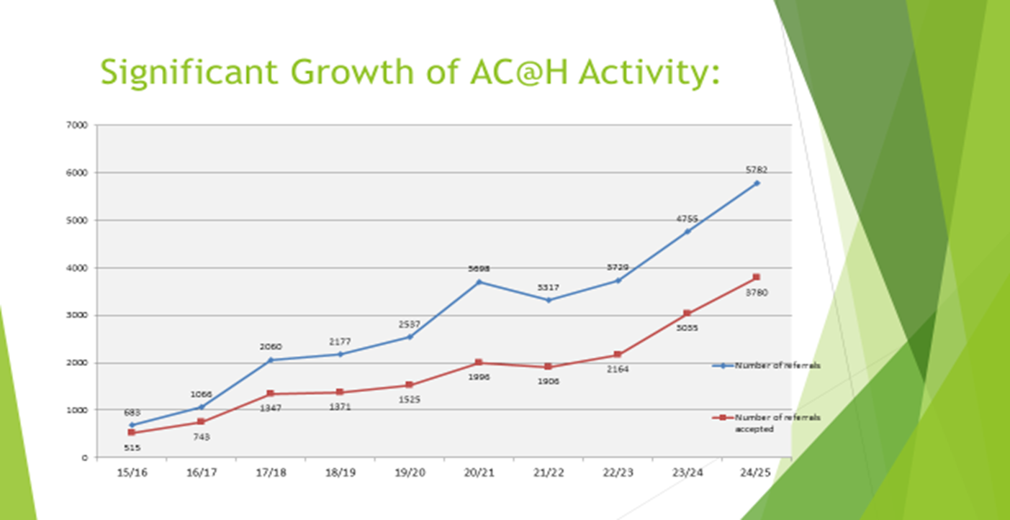

Slide 18
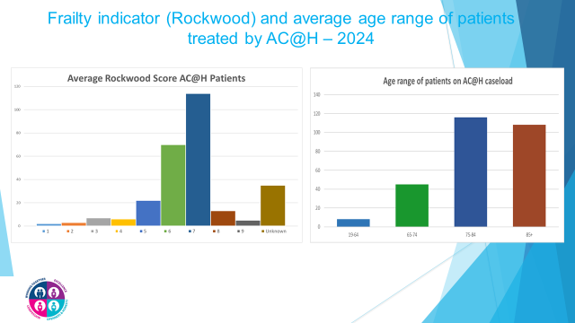

Slide 19
H@H outcomes 1/4/24-31/3/25
5782 referrals to HAH service.
3780 were accepted
91% step up in community
9% step down from hospital
Average LOS 3.98 days with HAH

Slide 20
H@H outcomes 1/4/24-31/3/25
3643 patients discharged
2.3 % deceased
8.7% admitted to acute or non acute hospital
1.7% of these patient had a new or increased domiciliary care package
84.8 % of these patient had no change in their domiciliary package or care home placement

Slide 21
H@H staffing
Discipline | Current 2025 staffing
Managerial | 1 x Team Manager 8a 1x Nurse Gov lead 8a
Nursing | 7.6 x band 3, HCAs 31.88 x band 5, SNs 20.88 x band 6, Clinical Sisters 19.89 x band 7, SPNs 3 x band 8a ANPs
Medical | 4 permanent and 2 locum consultants 2 Specialist Doctors/0.4wte GP specialist interest 7.86 Speciality doctors /4 locum doctors

Slide 22
H@H staffing
Discipline | 2025 staffing
Pharmacy | 1 wte bd 8a lead pharmacist 5.8 bd 7 pharmacist 2.8 bd 5 pharmacy technicians
Physio | 3.6 wte bd 7 physio, 5 wte bd 6 Physio
Dieticians | 2.5 wte bd 7 Dietitians
SALT | 3.5wte bd 7 SALT
OT | 2.24 bd 7 OT, 2.22 bd 6 OT
Admin | 3 wte admin support

Slide 23
The patient experience
Acute Care at Home - Seamus Murphy

Slide 24
H@H challenges
Staffing / training / staff progression + retention
Team capacity
Expansion of service
Ensuring equitable service delivery
Ensuring high quality service delivery / team governance

Slide 25
Southern Trust Lessons - FIT/H@H
Phased roll out of service
Strong leadership - in all domains
Investing in the right staff
Listen to the patient/carer voice
Referral process needs to be right
Ensuring your frailty service links up
Learning and engagement -regional / national/ international level

Slide 26
Questions ?

