Slide 1

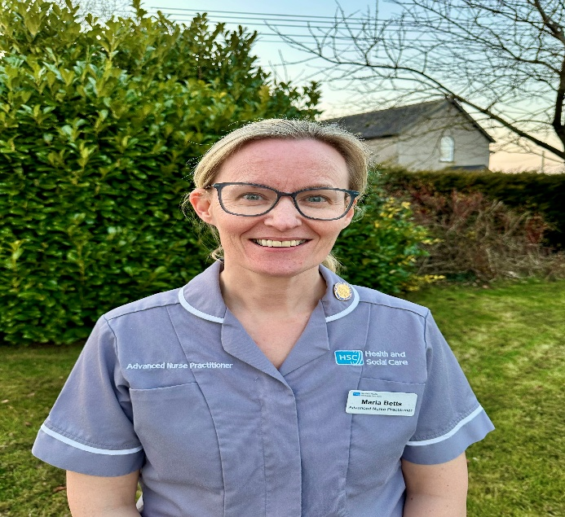
Frailty Focus: Empowering Rural Health with Advanced Nurse Practitioners (ANPs)
Maria Betts
Advanced Nurse Practitioner District Nursing
01-10-2025

Slide 2
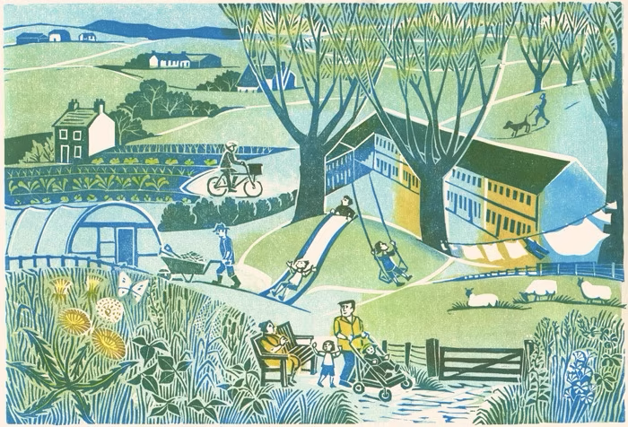
Frailty in rural areas
Background
Impact on patients and services
How the ANP can address these issues

Slide 3
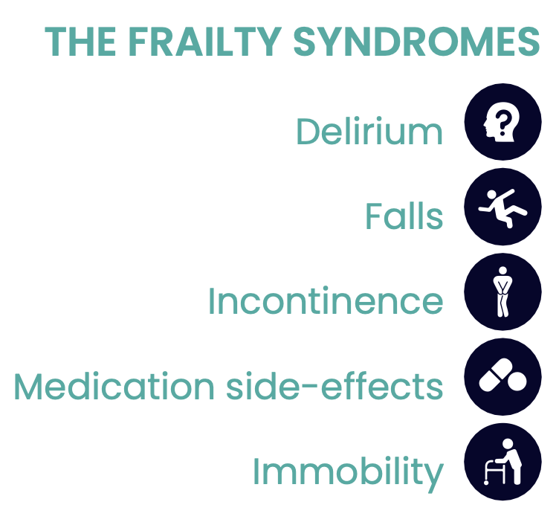
Frailty
Frailty is a distinctive health state related to the ageing process in which multiple body systems gradually lose their in-built reserves (British Geriatric Society 2014)

Slide 4
Background
1.8 million people in the UK aged ≥60 were living with frailty in 2016 with 65% of those aged ≥90 (National Institute of Health Research 2017)
Acute frailty services are crucial with 11.1 million of the population aged >65 with estimates to increase to 25% in the next 20 years (NHS England 2024)
Policies and Strategic Drivers
Policies and Strategic Drivers
Making Life Better-Strategic Framework for Public (Health Department of Health (DH) 2014)
Advanced Nursing Practice Framework (DHSSPS 2016)
NHS Long-Term Plan (2019)
NHS Right-Care; Frailty Toolkit (NHS 2019)
Enhancing Clinical Care Framework (DH 2023)
Notes:
Ageing population

Slide 5

Impact of frailty on patients and services
Frail patients account for 22% of ED attendances – highlighting the need for coordinated community services and support (O’Caoimh et al. 2023)
Older people in rural areas often experience inequality i.e. transportation, access to services
Older people in rural areas experience loneliness, depression, isolation, reduced access to appropriate care resulting in suboptimal health outcomes (Scholes-Robertson et al. 2022)
Less consultants in rural areas (Irmia et al. 2021)

Slide 6
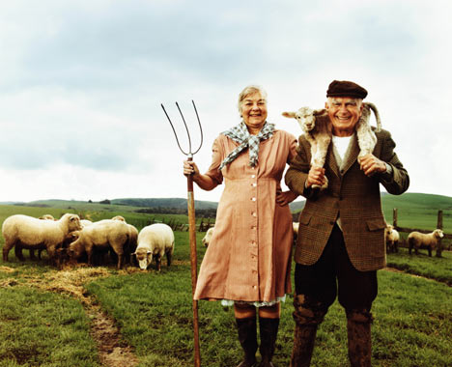
How can the ANP improve health outcomes for those living with frailty in rural areas?

Slide 7
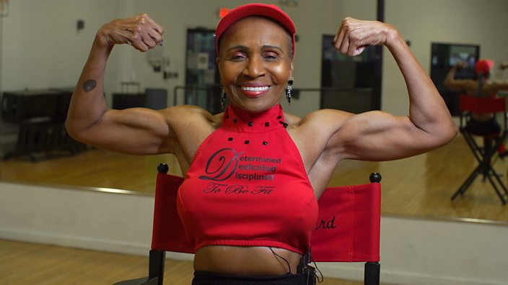
Why the ANP?
Advanced history-taking, physical assessment, differential diagnosis and decision-making skills improve health outcomes (DHSSPS 2016).
Undertaking Comprehensive Geriatric Assessments at home provide patients with more autonomy (BGS 2014; Huang et al. 2020)
Shared decision-making, co-produced treatment plans, regular reviews
The holistic approach bridges the delays that can result from disjointed healthcare systems (Thompson 2021)
↓ attendances at emergency departments
↑ access to community services
Patient satisfaction, improved patient outcomes, control of chronic disease and cost-effective (Htay and Whitehead 2021)
Notes:
Old does not automatically mean frail
Proactive models of care to prevent hospital admissions i.e. farm family health checks
Interdisciplinary and interagency working
Reduces mortality and increases independence
CGA and individualised care planning can reverse frailty (Whitty 2023)
Evidence to sho CGA reduces carer burden (Htay and Whitehead 2021)
ANP DN has knowledge of multiple specialities
Signposting – community navigator

Slide 8
Case study
94 yr old female referred by DN for CGA as 4+ falls in past 6 months
  Retired factory worker
  1 son (own health issues)
  Lives alone, 2-storey house, stair lift
  Mobilises with Ax1-2 – wheeled zimmer frame
  Alternating air cushion
  PoC 2x4x7 – personal hygiene, dressing , meals
  Body wash at sink, toilet upstairs, raised toilet seat
  Pendant alarm
  Light housework. Private cleaner and gardener
Notes:
2 falls in the 2 weeks prior to referral. Fell 9 weeks ago – leaned against 4 – wheeled kitchen trolley and it moved and patient fell. No head injury or loss of consciousness. No other evident injuries. No medical attention sought. Patient had a further fall 5 days later when her son found her lying between the sofa and chair in the living room. She had a long lie ? up to 4 hours. She was assisted her back onto the chair by her son after being contacted by the personal alarm company. She was ‘freezing but felt ok after 10mins - no medical attention sought. Multiple falls over the past year – unable to recollect all of them. Fell approx. 1 year ago – fell in kitchen, stumbled backwards and hit head off radiator. Helped up by carer. Attended hospital – sent home same day. Pattern of falls – always falls backwards with occasional dizziness but reports that legs just ‘give way’ as she has little strength in them.

Slide 9
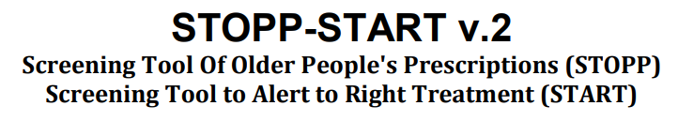
Medications
Piroxicam 0.5% gel
Hylo-care eye drops
Senna 7.5mg PRN
Paracetamol 500mg PRN
Sertraline 50mg OD
Amitriptyline 10mg nocte
Brinzolamide eye drops
Latanoprost eye drops
Esomeprazole 40mg OD
Aspirin 75mg OD
Bendroflumethiazide 2.5mg OD
Fortisip
Hyoscinebutylbromide 10mg OD
Loperamide 2mg PRN
Lactulose PRN
OTC: Well Woman 75+
Anticholinergic Burden Score – 5 Falls Risk Increasing Drugs score – 5
Allergic to butrans patch, ibuprofen gel, erythromycin, alupent syrup, ketoprofen gel, tamadol
Manages own medications. Patient admits to getting mixed up as to whether she has taken her medications or not. Eye drops administered by carers. Medications delivered by chemist.

Slide 10
Assessment
No sight test for > 5years. Bilateral cataracts
Incontinent urine
Chronic pressure ulcer to R buttock > 1yr
No weight loss/night sweats/swallowing issues
Diverticulitis – bowels fluctuate
Weight – 43.5kg BMI 18.8
Sitting BP – 159/88, on immediately standing 155/88, at 1 min standing 156/84
HS I+II+0. Mild ankle oedema. JVP not raised. HR 75 bpm and regular
RR 14/min. Sp02 97%. Chest clear – no additional breath sounds
Abdomen soft and non-tender
No red flags

Slide 11
Assessment
Abbreviated Mental Test Score – 7/10
Benign essential tremor for the past 20+ years – affects upper limbs and voice
Power upper limbs – 3/5 bilaterally and lower limbs 5/5 right, 4/5 left side. Chronic knee and back pain
Co-ordination reduced due to tremor and slight shuffling gait. Normal sensation in all 4 limbs. Romberg's +ve
Some bradykinesia. Mild cog-wheel rigidity
Bone health - intermediate risk of an osteoporotic fracture on the FRAX calculation. No DEXA scan completed, not suitable for same

Slide 12
Problem list
Falls
Reduced mobility
Polypharmacy
Rockwood Clinical Frailty Score – 7
Chronic Pressure Ulcer
Left knee and lower back pain
FRAX – high risk for fragility fracture
Anticholinergic burden score (ACB) – 5
Falls Risk Increasing Drugs (FRIDS)
Creatinine Clearance 26

Slide 13
Management plan
FRAX score
Bloods – bone profile, iron profile, b12 & Folate, U&E, FBP, TFT, HbA1c, lipids, urinalysis
Stop amitriptyline
Increase paracetamol frequency to 4 times daily and reduce dose to 500mg (<50kg)
Remove rug in living room
Refer for medicare/blister pack
Accrete D3 once a day chewable tablet (Adj Ca 2.42)
Referral to domiciliary OT and physio for assessment
Son to arrange sight test with optometrist
Liaise with GP and GP pharmacist – discharge letter
Review - Pressure ulcer healed 8 weeks after consultation

Slide 14
What next?
Future strategies should consider the absence of ANP regulation and include ANPs in policymaking to enhance patient outcomes and population health
Promoting health with innovative approaches in areas that may be overlooked can help the older person to remain independent
Getting things right would have immeasurable benefits; therefore, an acceleration into researching frailty in rural areas is required to fill the gaps in the evidence-base
Notes:
ANPs are an integral part of improving health for frailty through collaboration with MDT and use their unique skills to promote health and independence
ANPS need to empower older people with frailty and their families.
Although we have hospital at home – it is reactive. We need a proactive approach – health promotion and education

Slide 15
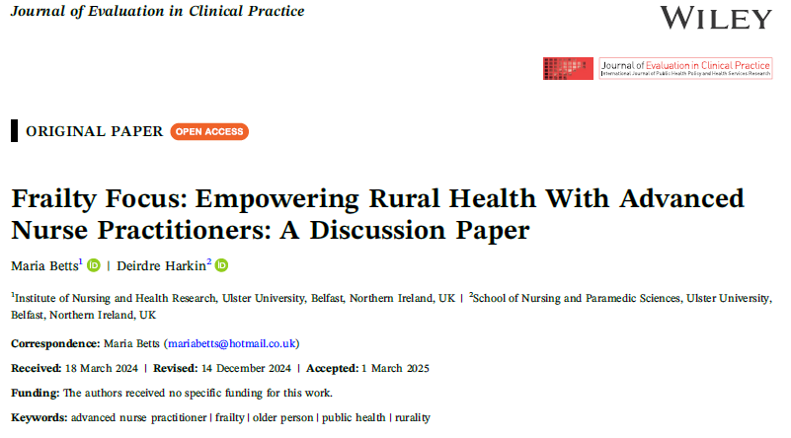
http://dx.doi.org/10.1111/jep.70075

Slide 16
References
Age UK. (2020) Understanding Frailty. London: Age UK. Available at: https://www.ageuk.org.uk/our-impact/policy-research/frailty-in-older-people/understanding-frailty/#:~:text=If%20someone%20is%20living%20with,recover%20quickly%20following%20health%20problems [Accessed 14 January 2024].
British Geriatric Society. (2014) Introduction to frailty, fit for frailty part 1. London: BGS. Available at: https://www.bgs.org.uk/resources/introduction-to-frailty#:~:text=Frailty%20is%20a%20distinctive%20health,lose%20their%20in%2Dbuilt%20reserves [Accessed 14 August 2024].
Department of Health. (2014) Making Life Better-Strategic Framework for Public Health. Belfast: DH. Available at: https://www.health-ni.gov.uk/sites/default/files/publications/dhssps/making-life-better-strategic-framework-2013-2023_0.pdf [Accessed 14 August 2024].
Department of Health, Social Services and Public Safety. (2016) Belfast: DHSSPS. Advanced Nursing Practice Framework: Supporting Advanced Nursing Practice in Health and Social Care Trusts. Available at: https://www.health-ni.gov.uk/sites/default/files/publications/health/advanced-nursing-practice-framework.pdf [Accessed 14 August 2024].
Department of Health. (2023) Enhancing Clinical Care Framework. Belfast: DH. Available at: https://www.health-ni.gov.uk/sites/default/files/publications/health/doh-enhancing-clinicla-care-framework.pdf [Accessed 10 August 2024].
Htay, M. and Whitehead, D. (2021) The effectiveness of the role of advanced nurse practitioners compared to physician-led or usual care: A systematic review. International Journal of Nursing Studies Advances, 3(21), 21-43.
Huang, C., Lee, W., Lin, H., Chen, R., Lin, C., Peng, L. and Chen, L. (2020) Epidemiology of frailty and associated factors among older adults living in rural communities in Taiwan. Archives of Gerontology and Geriatrics, 87(3), 365-381.
National Health service. (2019) NHS RightCare: Frailty Toolkit. London: NHS. Available at: https://www.england.nhs.uk/rightcare/wp-content/uploads/sites/40/2019/07/frailty-toolkit-june-2019-v1.pdf [Accessed 14 August 2024].
National Health Service (NHS). (2019) NHS – Long-term plan. London: NHS. Available at: https://www.longtermplan.nhs.uk/online-version/ [Accessed [Accessed 14 August 2024].
National Health Service England. (2024) Frail Strategy. London: NHS. Available at: https://www.england.nhs.uk/long-read/frail-strategy/ [Accessed 20 August 2024].
NIHR Dissemination Centre. Themed Review—Comprehensive Care: Older People Living with Frailty in Hospitals. National Institute of Health Research, 2017.
O’Mahony, D., O’Sullivan, D., Byrne, S., O’Connor, M. N., Ryan, C. and Gallagher, P. (2014) ‘STOPP/START criteria for potentially inappropriate prescribing in older people: Version 2’, Age and Ageing, 44(2), pp. 213–218. doi: 10.1093
Thompson, S., Moorley, C. and Barratt, J. (2017) A comparative study on the clinical decision-making processes of nurse practitioners vs. medical doctors using scenarios in a secondary care environment. Journal of Advanced Nursing, 73(5), 1097-1110.
Whitty, C. (2023) Chief Medical Officer’s annual report 2023: health in an ageing society. London: NHS. Available at: https://assets.publishing.service.gov.uk/media/654cecdc5d6095000dbec88c/CMO_s-annual-report-2023-health-in-an-ageing-society-full-report.pdf [Accessed 10 January 2024].

