Slide 1

Leadership Approaches to Promote Quality in Long Term Care Delivery
My Home Life
Sarah Penney
Associate Director My Home Life Northern Ireland
My Home life Charity Trustee

Slide 2

My Home life is a programme of support and development for leaders, predominately in long term care but is applicable in many settings
But first let me tell you a story ….

Slide 3
My Dad
81
Independent
Chairman various committees
Recent hip replacement – rehab by the book
Recent day procedure unit
Positive experience +++

Slide 4
What made it positive
Anxious
Visit with GP re concerns. Dad felt heard, joined up thinking – Collaboration, Envision.
Communication – pre op assessment nurse happy to Co-create with daughter and dad
Receptionist staff empowered to make adjustments Discover what mattered Envision
Communication immediately post procedure Collaboration, Envision
Delegation
minor missed communication
Staff owned it, transparent, no one was annoyed. Culture embedded
Outcome & Feedback ‘’ The best care and the nicest staff I could have wished for ’’

Slide 5
The leadership was effective how well do things go when the leader is not there?
Everyone working as a team Compromise when needed
Delegation was the norm & consider other perspectives
Everyone felt ownership in the unit. Able to make decisions. Collaborate
Connect emotionally with him
Courage to own any errors
Curiosity about what it could look like at its best for eaach patient –person centred
Celebrate success from this story

Slide 6
I believe ,
The best leaders build teams that no longer look to them for every answer — but know how to find it themselves.”
“A good leader inspires people to have confidence in the leader; a great leader inspires people to have confidence in themselves.”
– Eleanor Roosevelt, former First Lady of the United States

Slide 7

One proven successful way to help people develop their leadership within a team or organisation

Slide 8
So what is My Home Life
At present work with largely care home sector
Groups of 16-20 participants
Workshops to explore the underpinning frameworks
Workshops to actively complete a QI project using PDSA & Appreciative Inquiry an approach developed with MHL
Action learning regularly to review real life issues & Topics
Use of appreciative inquiry in real time and practice,practice, practice

Slide 9

Insert framework slides

Slide 10
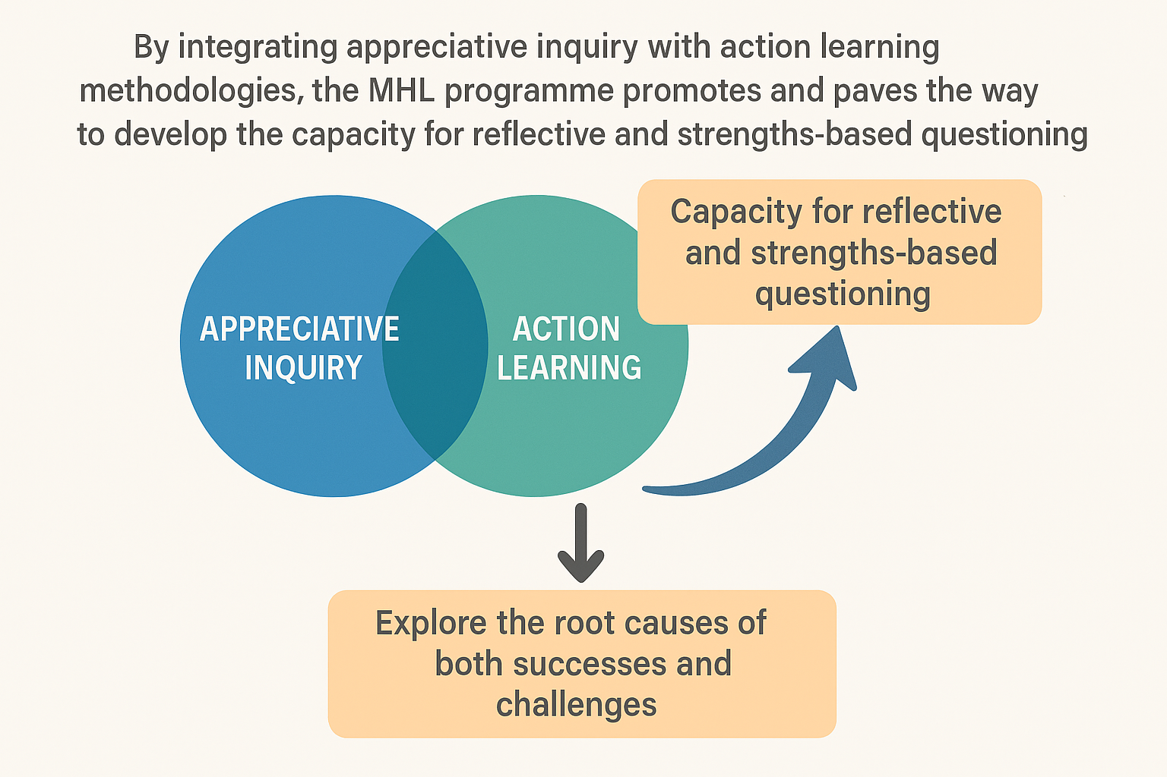

Slide 11
Personal impact
is about how the participant changed as a result of the programme -----— their mindset, self-perception, and emotional regulation.
Impact on Leadership Behaviour:
Leadership impact reflected how the personal impact changes described above, translated into external behaviours when they were leading others.
Staff Empowerment influencing Care Delivery
Participants noticed a shift in staff behaviour, with increased willingness to take responsibility and contribute ideas. Staff felt more valued, leading to improved experiences for residents

Slide 12
MHL - What our participant's tell us
They develop better delegation skills
Staff feel empowered to make decisions
Everyone is working toward the same goal
We work more as a team now, as the manager, I don’t have to make all the decisions
Patient/resident care is improved
Better relationships with patients/residents and family members
New approaches & improvements in care delivery
= Better Outcomes for Patients/Residents

Slide 13
International Initiative
MHL is an international initiative ,in England, Scotland, Wales , NI, Australia and at present Sweden exploring the impact of MHL
20 years celebrations in 2026 worldwide
11 years in Northern Ireland
    Mainly delivered in care homes in NI
    Some supported housing and Domiciliary care have completed and recommend
    Has been introduced, in Mental Health -Australia, -Acute services - UK, Midwifery Uk etc

Slide 14
Quality outcome for long term care
Participants have developed high quality QI with positive impact for patients
  Oral health for residents of care homes
  NISCC campaign during pandemic
  Roadmap for Meaningful Engagement
  NIPSO guidance document for handling new complaints procedure
  Transitions guidelines for moving into care home
  Reminiscence App development
  Many many more
Developed a new tool to measure leadership specially in long term care – LLCI

Slide 15
Thank you
s.penney@ulster.ac.uk

