Slide 1


Exploring 'Front Door Frailty' Options
Medicines Optimisation in Older People (MOOP)
Stephanie Park
Lead Care Homes Pharmacist, MOOP, Northern Health and Social Care Trust

Slide 2
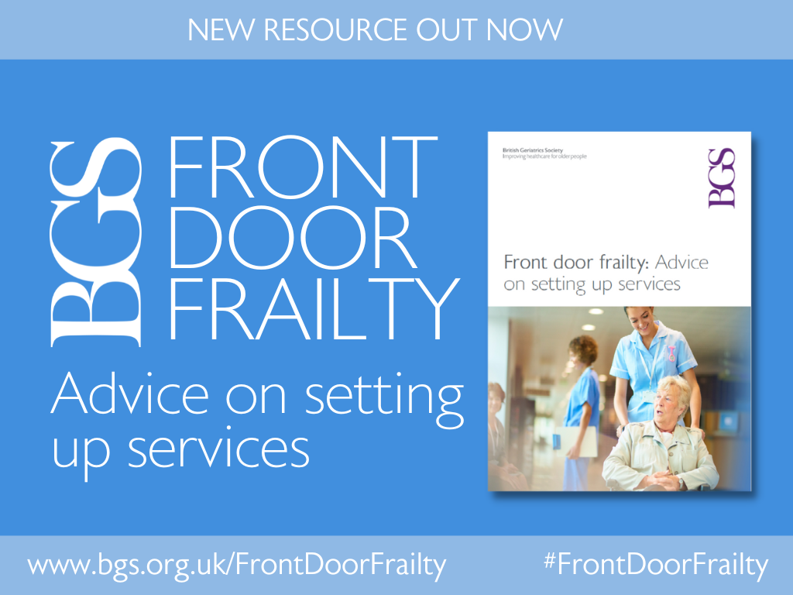
Front Door Frailty (FDF)
Identify patients with frailty at the hospital front door i.e. ED
Trigger a comprehensive geriatric assessment early (CGA)
Medicines review and optimisation is a component of CGA.
Improve the experience and health outcomes of older people in ED
Improve patient flow and reduce pressure on the whole hospital
No set way to implement/run

Slide 3

Craigavon Area Hospital Emergency Department
1wte Band 7 Frailty pharmacist temporary winter pressures funding
Pharmacist role
  Initial priority was near patient dispensing and completion of discharges to speed up discharge from ED
  Focus later changed to medicines reconciliation for all patients
February 2025 – average 7 patients daily by the team in ED
  53% medicines optimisation review completed by pharmacist
March 2025 – average 10 patients daily
  52% medicines reconciliation completed by pharmacist

Slide 4
Patient AB
Interventions
78 year old male
Presenting complaint: UTI, frailty, undiagnosed cognitive impairment, confusion, hypoglycaemia
Past medical history: T2DM, HTN, TKR
Pharmacist completed medication history with two sons. Patient prescribed insulin
Sons did not realise that different insulins are not inter-changeable. When one pen was finished they used the next available insulin pen, administering the same number of units. They did not know that Humalog mix 50, Levemir, Lantus and Novorapid are different insulins. Pharmacist educated sons.
Safeguarding issues raised by son – ‘patient aggressive towards wife’. This may have been caused by hypoglycaemia due to insulin management. APP1 screened by social worker.
Diabetes team contacted to agree a new management plan and arrange follow up with family once patient discharged.
Medication history/ reconciliation/ education
Improving health literacy through education and written information
Educating patients/ carers/ care homes
Circumvent blister pack dispensing to reduce pressure on dispensary
Arrange amendment of Home Care medicine instruction sheets
STOPP inappropriate polypharmacy
Calculate and reduce anti-cholinergic burden
START appropriate medicines
Communication with GPs/ AHPs etc
Communication of zoledronic acid infusion administration
Changes to blister packs
Additional monitoring

Slide 5


Pharmacist Medicine Review Pilot - Frailty in ED / AMU
Medichec
Currently no pharmacist focusing on frailty working in ED / AMU
AMU pharmacist dedicated time to reviewing frail patients in ED / AMU
Worked alongside consultant and ANPs in frailty team
23 patients reviewed (CFS of ≥ 6 and ≥ 75 years)
PILOT AIM
To evaluate the impact of a pharmacist reviewing frail patients in Acute Medicine / ED
EVALUATE
Before + after review= No. of meds prescribed, Anticholinergic Burden (ACB / AEC)
Interventions (grade/impact using Eadon)
Number of side effects potentially reduced
Notes:
A post graduate masters project

Slide 6
Results
Statistically significant reduction post review:
Total number of meds prescribed
ACB (11 experienced a reduction)
AEC (7 experienced a reduction)
The number of medications potentially causing common ADRs pre and post review
Eadon grade - intervention
104 interventions made across 23 patients (av. 4.5)
83% of interventions at Eadon grade ≥ 3
Every category of common side effect reduced
16 of the 23 patients had one of these side effects listed as part of their reason for admission
Notes:
Frail patients more likely to suffer ADRs – seems prudent to review medications which potentially cause common side effects and stop / reduce if possible
16 of the 23 patients reviewed had one or more of these 6 common side effects listed as part of their reason for admission – in theory reducing the number of medications that potentially cause these side effects could reduce the likelihood of re-admission.
Patients’ meds lists were evaluated pre and post review using the tool on medichec.com and the number of meds potentially causing the common side effects noted pre and post review
4 out of the 6 potential ADRs were statistically significantly reduced (QTc prolongation, hyponatraemia, bleeding and drowsiness)
Another way of demonstrating the positive impact a pharmacist carrying out medication reviews can have on older frail individuals

Slide 7

A MOOP pharmacist in Antrim Area ED for 2 weeks.
Aim
To assess the impact of medicines optimisation by a MOOP IP pharmacist for older patients attending the AAH ED
Outcomes
32 patients reviewed
66% had attended due to a fall or collapse
Number of patients reviewed | Average patient age | Percentage of males | Percentage of females | Average CFS | Average no. of medications taken per patient at ED attendance | Average no. of medications with a falls risk taken per patient at ED attendance
32 | 87 years (range 75-97) | 37% | 63% | 5.5 (range 3-7) | 10.4 (range 2-20) | 2.4 (range 0-5)

Slide 8
The number of medicine optimisation interventions by Eadon grade¹, and their corresponding potential healthcare cost avoidance, modelled by ScHARR².
An average of 3.6 (range 1-8) interventions per patient
 | Number of medicine optimisation interventions | Cost avoidance modelled by ScHARR
Eadon grade 3 (significant but does not lead to an improvement in patient care) | 11 (10%) | £0-£66 (av. £38.50)
Eadon grade 4 (significant and results in an improvement in the standard of care) | 92 (80%) | £5980– £13800 (av. £9936)
Eadon grade 5 (Significant & prevents a major organ failure or adverse reaction of similar importance) | 12 (10%) | £9720 – £14748 (av. £12246)
Total | 115 | £15700- £28614 ( av. £22220.50)
Eadon, H. (1992). Assessing the quality of ward pharmacists’ interventions. International Journal of Pharmacy Practice, 1(3), pp. 145-147. https://doi.org/10.1111/j.2042-7174.1992.tb00556.x.
Karnon, J., McIntosh, A., Dean, J., Bath, P., Hutchinson, A., Oakley, J., Thomas, N., Pratt, P., Freeman-Parry, L., Karsh, B. T., Gandhi, T., & Tappenden, P. (2008). Modelling the expected net benefits of interventions to reduce the burden of medication errors. Journal of Health Services Research and Policy, 13(2), pp. 85-91. https://doi.org/10.1258/jhsrp.2007.007011.
Notes:
A Falls Risk Increasing Drugs (FRIDs) score and anticholinergic burden (ACB) score⁹ were calculated for each patient before and after medication optimisation review. A reduced FRIDs and/or ACB score after medication review is an indicator of improved prescribing and, in the case of FRIDs, a reduction in falls risk. In this study the FRIDs score was reduced for 22 of the 32 patients reviewed (69%). Average FRIDs score before and after medication optimisation review fell from 5.3 to 3.5. Only 50% (16) of the patients reviewed were taking a medication with an anticholinergic burden. Of these patients the ACB score was reduced for 5 of the patients, 31%.

Slide 9
Going forward....
In the NHSCT a pharmacist is to be employed to work with EIT team in ED
In SEHSCT and SHSCT hoping to secure recurrent funding for a frailty pharmacist

