Slide 1







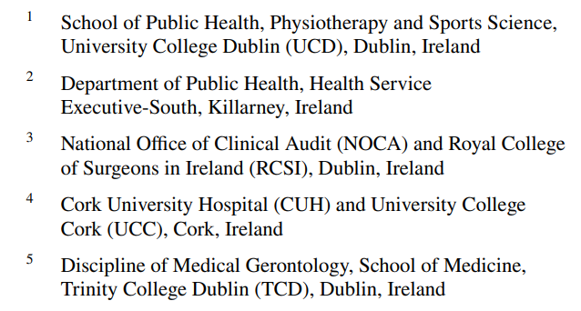

Operationalising Frailty in the Irish Hip Fracture Database
Mary Walsh¹, Helena Ferris², Louise Brent³, Emer Ahern⁴, Tara Coughlan⁵, Roman Romero-Ortuno⁵
Northern Ireland Frailty Network Conference, Wednesday 1st October 2025

Slide 2
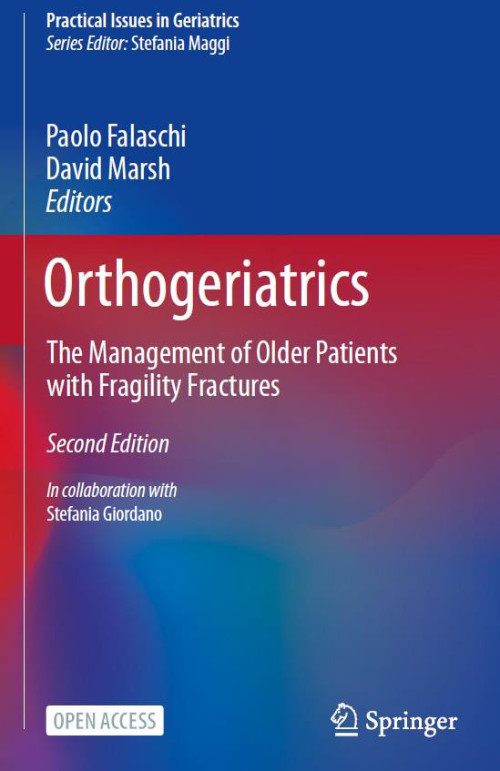
Orthogeriatric Care
Defined as care for older fracture patients which combines expert management of fragility (of the fractured bone – ‘ortho’) and frailty (of the whole patient – ‘geriatric’).
Includes the whole post-fracture pathway, including rehabilitation
and secondary prevention, as well as acute management.
It does not necessarily require Geriatricians – but people trained in the management of frailty.
“There is compelling evidence that CGA improves outcome: early Orthogeriatrician review helps avoid delay to surgery, improves perioperative care, and expedites rehabilitation and discharge
planning” NHFD 2021

Slide 3


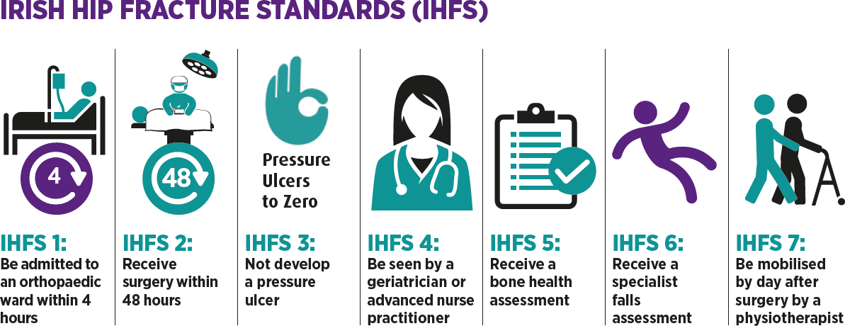
Irish Hip Fracture Database
The IHFD was Established in 2012.
It is a clinically led web-based database focusing on clinical standards and outcomes.
8+ reports published
25,000+ cases reported
Best practice tariff was introduced in 2018 Meet all six clinical standards and two data quality standards and hospitals receive extra
€1000 per case.

Slide 4
Background & aims 1
Walsh M, Ferris H, Brent L, Ahern E, Coughlan T, Romero-Ortuno R.
Development of a Frailty Index in the Irish Hip Fracture Database.
Arch Orthop Trauma Surg. 2023 Jul;143(7):4447-4454.
In older people, hip fracture can lead to adverse outcomes.
Frailty, capturing biological age and vulnerability to stressors, can indicate those at higher risk.
We aimed to derive a frailty index (FI) in the Irish Hip Fracture Database (IHFD), to explore associations with:
  Prolonged length of hospital stay (LOS ≥ 30 days)
  Delirium
  Inpatient mortality
  New nursing home (NH) admission
We also assessed whether the FI added value to those predictions above and beyond age, sex, and pre-operative American Society of Anaesthesiology (ASA) score.

Slide 5
Methods
A 21-item FI was constructed with:
  16 dichotomous comorbidities
  three 4-level ordinal pre-morbid functional variables (New Mobility Score)
  and nursing home provenance (yes/no)
The FI was computed as the proportion of items present, and divided into tertiles.
Independent associations between FI and outcomes were explored with logistic regression, from which we extracted adjusted Odds Ratios (aOR) and areas
under the curve (AUC).

Slide 6
IHFD FI21 | Scoring
Ischemic heart disease | No = 0 Yes = 1
Peripheral vascular disease | No = 0 Yes = 1
Congestive heart failure | No = 0 Yes = 1
Chronic obstructive pulmonary disease | No = 0 Yes = 1
Hypertension | No = 0 Yes = 1
Diabetes mellitus | No = 0 Yes = 1
Dementia | No = 0 Yes = 1
Stroke/ hemiplegia | No = 0 Yes = 1
Chronic renal disease | No = 0 Yes = 1
Cancer | No = 0 Yes = 1
Parkinson’s disease | No = 0 Yes = 1
Arthritis | No = 0 Yes = 1
Reflux/ peptic ulcer disease | No = 0 Yes = 1
Chronic liver disease | No = 0 Yes = 1
Atrial fibrillation | No = 0 Yes = 1
Previous fragility fracture | No = 0 Yes = 1
Pre-admission pressure ulcer | No = 0 Yes = 1
Indoor mobility | No difficulty and no aid = 0; with a walking aid = 0.33; with help from another person = 0.67; unable = 1
Outdoor mobility | No difficulty and no aid = 0; with a walking aid = 0.33; with help from another person = 0.67; unable = 1
Shopping | No difficulty and no aid = 0; with a walking aid = 0.33; with help from another person = 0.67; unable = 1
Nursing home resident pre-fracture | No = 0 Yes = 1

Slide 7
Results
From 2017-2020, the IHFD included 14,615 hip fracture admissions:
  mean (SD) age 80.4 (8.8)
  68.9% women.
Complete FI data was available for 12,502 (85.5%).
 | Low tertile N = 4830 | Medium tertile N = 3981 | High tertile N = 3691
Mean age (SD) | 76.9 (8.6) | 81.7 (8.4) | 83.7 (7.8)
Female sex [n (%)] | 3453 (71.5) | 2788 (70.0) | 2454 (66.5)
ASA grade (n %)
I or II | 2790 (57.8) | 1211 (30.4) | 547 (14.8)
III | 1593 (33.0) | 2203 (55.3) | 2264 (61.3)
IV or V | 83 (1.7) | 226 (5.7) | 513 (13.9)
Unknown | 364 (7.5) | 341 (8.6) | 367 (9.9)
Type of fracture (n %)
Intracapsular | 2679 (55.5) | 1898 (47.7) | 1795 (48.6)
Intertrochanteric/ Subtrochanteric | 1837 (38.0) | 1808 (45.4) | 1636 (44.3)
Other | 314 (6.5) | 175 (4.4) | 260 (7.0)
Type of surgery (n %)
Arthroplasty | 2576 (53.3) | 1907 (47.9) | 1751 (47.4)
Internal fixation | 2038 (42.2) | 1839 (46.2) | 1676 (45.4)
Other surgery | 92 (1.9) | 97 (2.4) | 74 (2.0)
Non-operative | 124 (2.6) | 138 (3.5) | 190 (5.2)
Notes:
Highlight that ASA grade is only thing the tertiles really differ on.

Slide 8
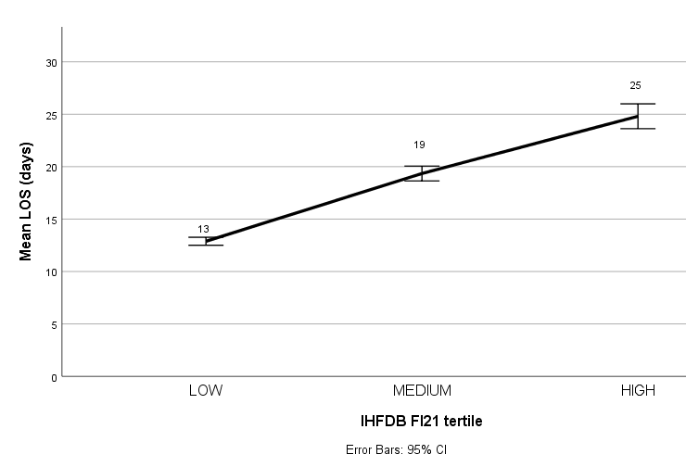
 | Low tertile N = 4830 | Medium tertile N = 3981 |  | High tertile N = 3691
 | % | % | aOR (95% CI) | % | aOR (95% CI)
Development of delirium | 5.5 | 13.5 | 2.20 (1.88–2.57) | 17.6 | 2.74 (2.34–3.20)
Prolonged length of stay (≥ 30 days) | 5.9 | 16.1 | 2.88 (2.48–3.35) | 23.1 | 4.38 (3.77–5.08)
New nursing home admission* | 2.2 | 5.9 | 2.22 (1.74–2.84) | 11.3 | 4.38 (3.43–5.59)
7-day inpatient mortality | 0.2 | 0.9 | 2.89 (1.49–5.61) | 2.8 | 8.30 (4.50–15.32)
14-day inpatient mortality | 0.3 | 1.6 | 4.16 (2.39–7.24) | 5.0 | 12.13 (7.20–20.45)
Overall inpatient mortality | 0.6 | 3.3 | 4.75 (3.17–7.10) | 10.1 | 14.74 (10.07–21.59)
All associations were statistically significant (p < 0.001) independently of age and sex.

Slide 9
 | Delirium | Prolonged LOS | Inpatient death | New nursing home admission
Model 1: Age, sex and ASA | 0.66 (0.65–0.68) | 0.64 (0.62–0.65) | 0.75 (0.73–0.77) | 0.64 (0.62–0.66)
Model 2: Age, sex, ASA + FI | 0.69 (0.67–0.70) | 0.70 (0.68–0.71) | 0.81 (0.79–0.83) | 0.67 (0.65–0.69)
Model 1 vs 2: p value for statistical comparison of AUCs | p = 0.011 | p < 0.001 | p < 0.001 | p = 0.047
AUC analyses suggested that the FI score, added to age, sex, and ASA score, added value to the prediction of delirium and new NH admission (p<0.05), and especially to prolonged LOS and inpatient mortality (p<0.001).

Slide 10
Background & aims 2
Ferris HA, Walsh ME, Merriman NA, Brent L, Hickey P, Regan NO', Coughlan T, Romero-Ortuno R. Identifying frailty in acutely hospitalised patients with hip fracture: are the clinical frailty scale and irish hip fracture database frailty index comparable for predicting adverse outcomes? Eur Geriatr Med. 2025 Jul 2.
Hip fracture in older adults is linked to high risks (delirium, prolonged stay, mortality), with frailty a key driver of poor outcomes.
Frailty can be measured using the Clinical Frailty Scale (CFS) or the Irish Hip Fracture Database Frailty Index (IHFD FI).
Study compared these two frailty measures in a subsample of patients from 2 hospitals.
Outcomes examined included delirium, inpatient mortality, prolonged hospital stay, and timely discharge home.

Slide 11
The study included 1,388 patients (mean age 80.0, 68.4% female).
Delirium occurred in 39.1%, inpatient mortality in 5.2%, prolonged LOS in 22.2%, and 33.6% were discharged home within 14 days.
CFS data were available for 84.4% and IHFD FI for 86.5%.
When added to age, sex and ASA, the CFS outperformed the IHFD FI for predicting delirium (AUC 0.816 vs. 0.790), while the IHFD FI was marginally better for mortality (AUC 0.778 vs. 0.744).
Both tools performed similarly for prolonged LOS and discharge home.

Slide 12
Conclusions
Walsh M, Ferris H, Brent L, Ahern E, Coughlan T, Romero-Ortuno R.
Development of a Frailty Index in the Irish Hip Fracture Database.
Arch Orthop Trauma Surg. 2023 Jul;143(7):4447-4454.
Ferris HA, Walsh ME, Merriman NA, Brent L, Hickey P, Regan NO', Coughlan T, Romero-Ortuno R. Identifying frailty in acutely hospitalised patients with hip fracture: are the clinical frailty scale and irish hip fracture database frailty index comparable for predicting adverse outcomes? Eur Geriatr Med. 2025 Jul 2.
Frailty strongly predicts poor outcomes after hip fracture (delirium, prolonged stay, mortality, new nursing home admission).
IHFD Frailty Index (21 items) adds predictive value beyond age, sex, and ASA—especially for inpatient mortality.
Clinical Frailty Scale (CFS) outperforms IHFD FI in predicting delirium due to its bedside cognitive/functional assessment.
Both tools perform similarly for prolonged hospital stay and early discharge home.
CFS (prospective use) = best for early delirium detection and timely intervention.
IHFD FI (audit data) = best for mortality risk and system-level monitoring.
Complementary use of both tools can optimise patient care and resource
allocation in hip fracture services.

Slide 13
Thank you!
We would like to acknowledge the assistance and continued support of
National Office of Clinical Audit
Healthcare Pricing Office
Irish Gerontological Society
Irish Institute of Trauma and Orthopaedic Surgery
And all clinical leads, local governance committees, local audit co-ordinators, National Irish Hip Fracture Database Governance committee, and all patients who have participated in the audit.
https://www.noca.ie/audits/irish-hip-fracture-database

