Slide 1
Autumn/Winter
Vaccination Programme 2025/26
Information for Care Home Managers
23rd September 2025
Rachel Spiers - Immunisation and Vaccination Programme Manager

Slide 2
Agenda
Overview of 2025/26 programme
Seasonal vaccination uptake rates
Role & expectation of health care workers re: vaccination
What you can do to improve vaccine uptake
Are you ready
Pharmacy
Managing an outbreak

Slide 3
Overview of 2025/26 programme
Flu | COVID-19
65’s and over | 75’s and over
All Care home residents & staff | Where there is a resident over the age of 75 then all residents in that care home are eligible If all the residents are under the age of 75 then only those who are immunosuppressed are eligible
Clinically at risk individuals (6mths +) | Immunosuppressed individuals (6mths +)
Pregnant women
Health and social care workers
Pre-school children
School children (up to year 12)
Close contacts of immunosuppressed
Carers
High risk poultry & avian animal health workers
Delivery
Community pharmacies – Care Home Residents and Staff
Programme commences: 6th Oct 2025
Programme ends:
  31st Jan 2026 (Covid-19)
  31st March 2026 (flu)
***HSCWs, inc. care home staff, no longer eligible for Covid-19 vaccine***

Slide 4
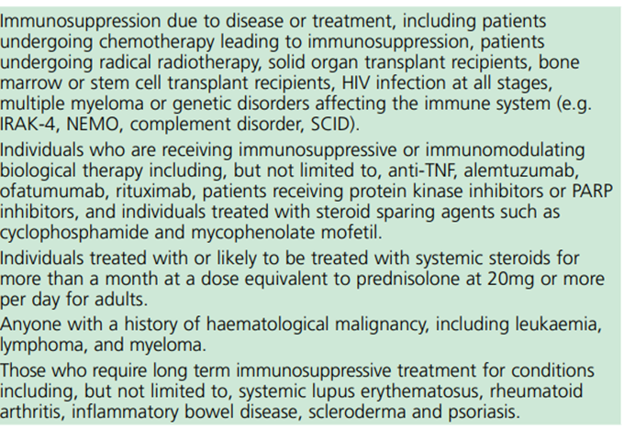
Immunosupression for homes where there are no residents under 75yrs old.
This information will be sent out in a separate communication via email
If in doubt check with residents GP and inform pharmacist in advance

Slide 5
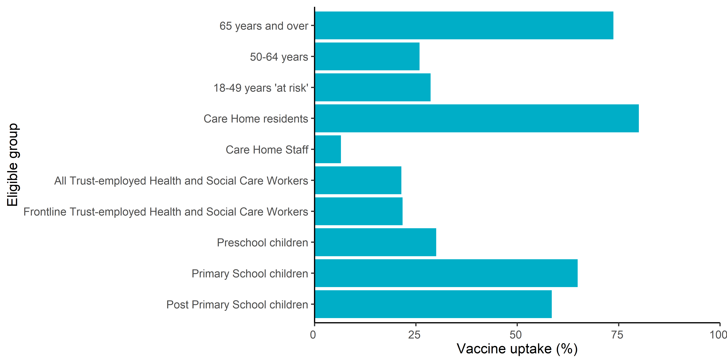
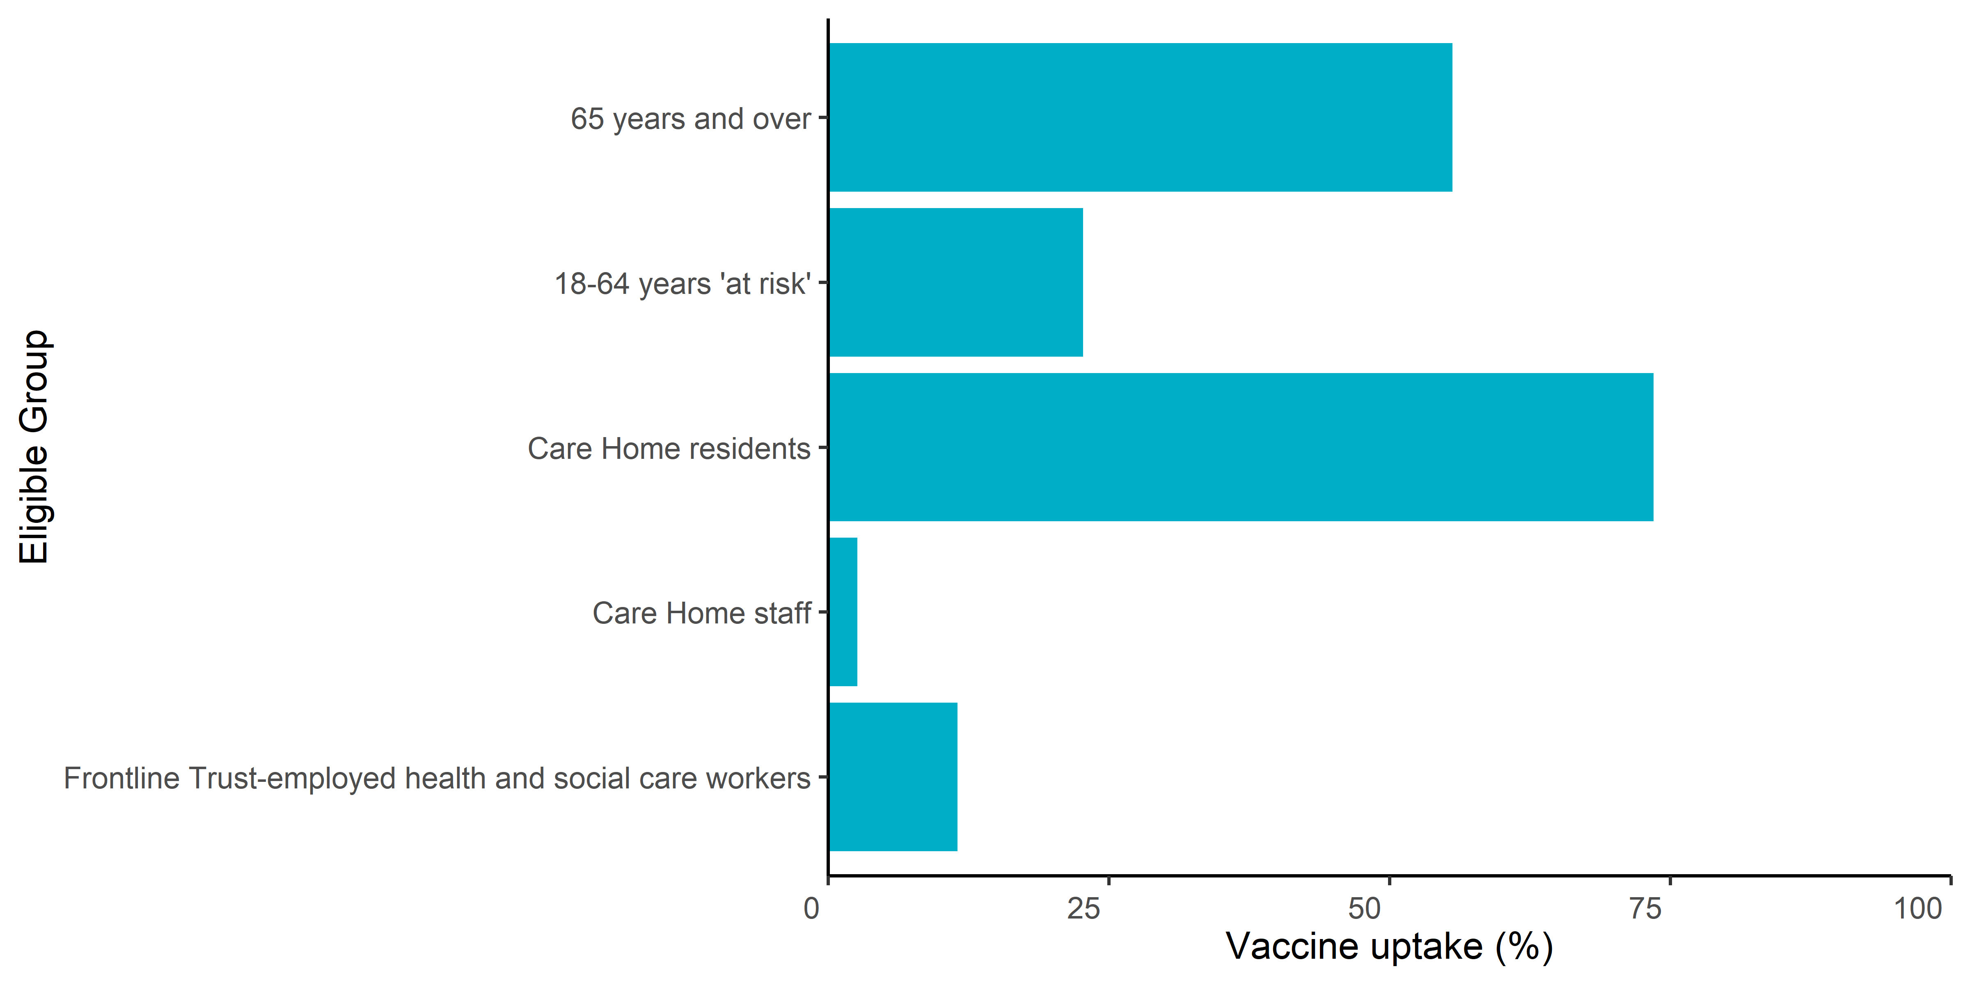
2) Seasonal vaccination: uptake rates
Flu (24/25 and 23/24)
COVID-19 (24/25 and 23/24)
73.7%
78.0%
25.9%
28.9%
55.6%
70.1%
28.6%
80.0%
81.6%
22.7%
6.5%
10.2%
21.4%
21.6%
73.5%
79.5%
21.7%
21.5%
30.0%
32.9%
2.6%
6.3%
64.9%
68.6%
58.5%
56.5%
11.5%
16.6%
Notes:
Influenza vaccination recording was introduced into the Northern Ireland Vaccine Management System (VMS) in 2021/22. Vaccine uptake in most eligible adult groups has decreased since 2022/23. Vaccine uptake has improved in individuals aged 18-49 years ‘at risk’, increasing from 11.9% in 2023/24 to 28.6% in 2024/25. Recording of ‘at risk’ eligibility criteria improved in 2024/25. Vaccine uptake remains highest in care home residents since 2022/23, however uptake has declined during this time from 82.5% in 2022/23 to 80% in 2024/25 (Figure 3.1).

Slide 6
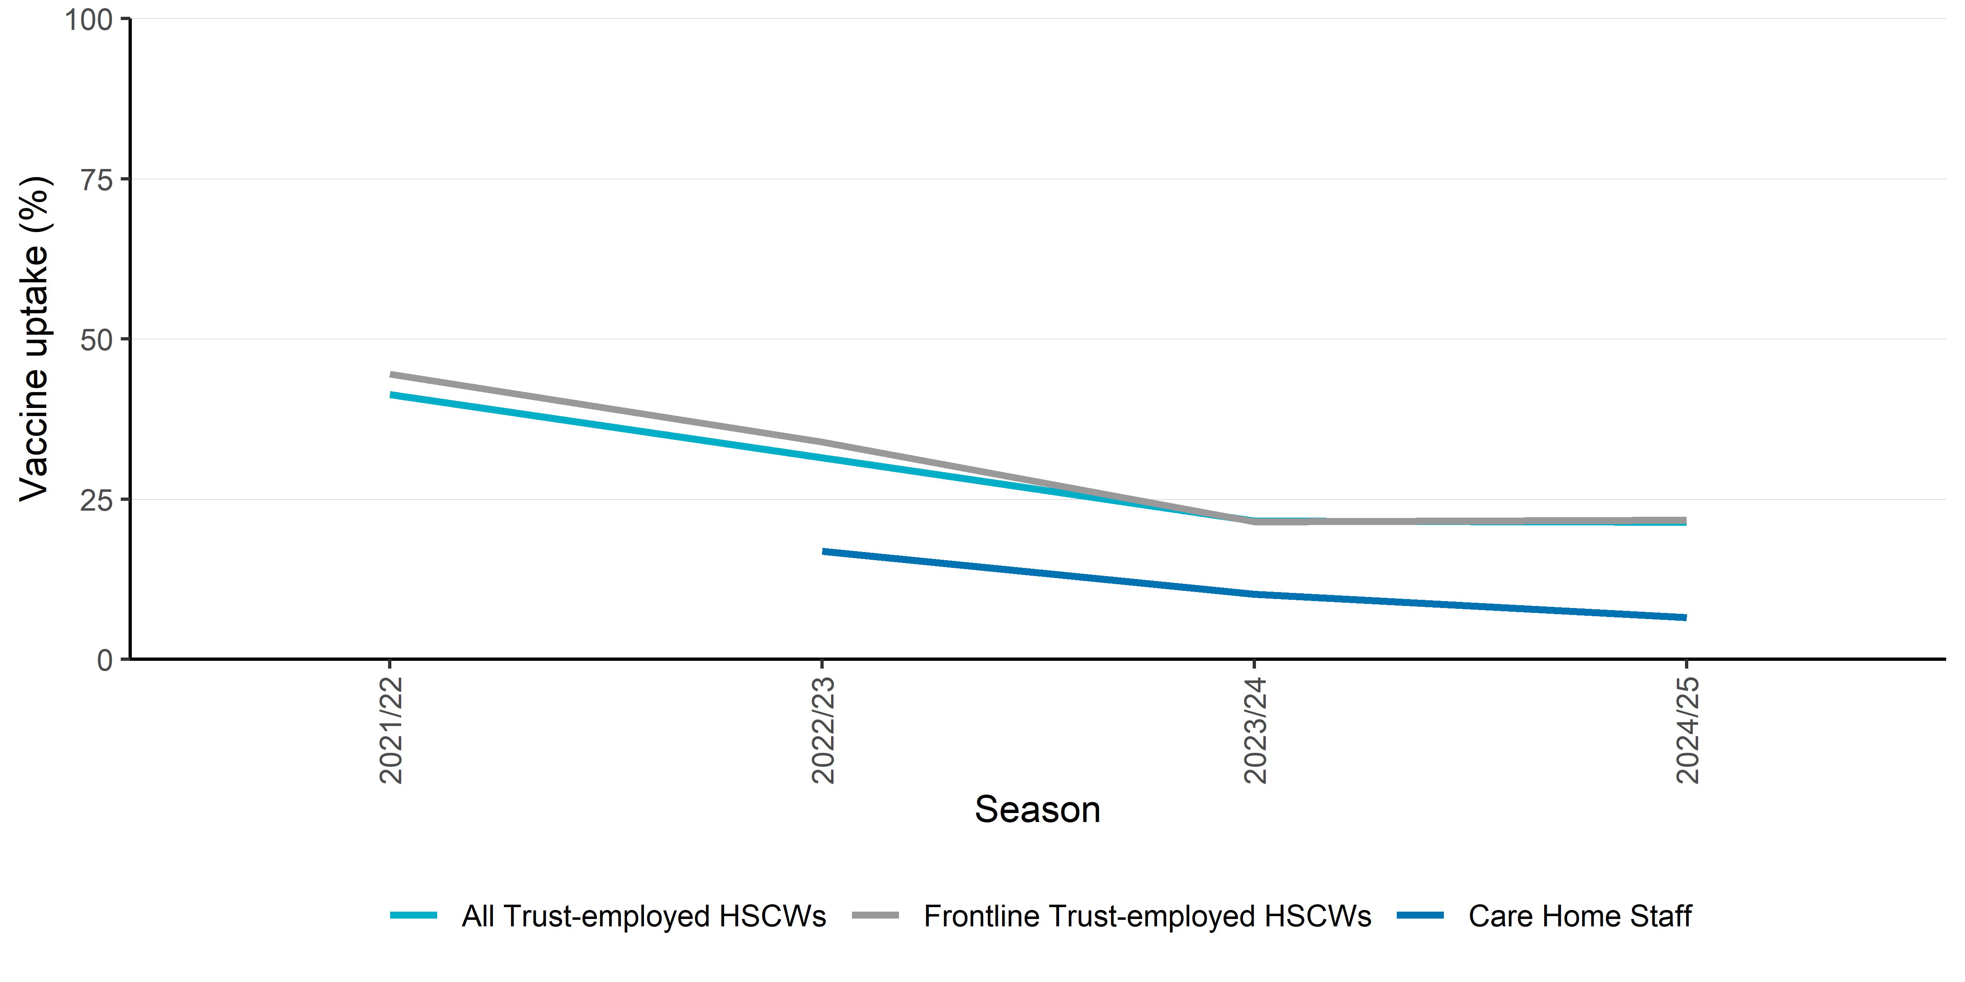
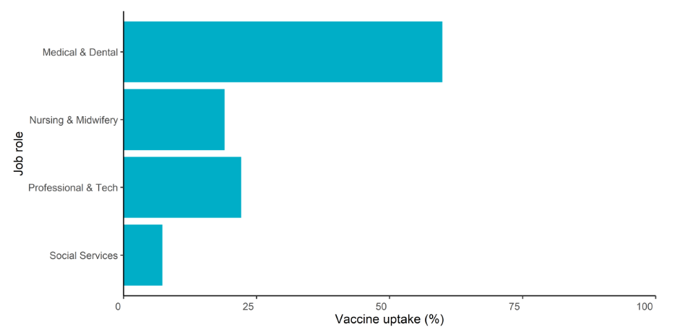
Flu vaccine: uptake rates
N.I HCW Flu vaccine uptake rates – 2021/22 to 2024/25
N.I HCW Flu vaccine uptake rates by job role, 2024/25
Care Home Staff 2024/25 - 6.5%
Source:
Seasonal influenza vaccination surveillance in Northern Ireland Autumn/Winter 2024/25 | HSC Public Health Agency
Notes:
Individuals may have more than one eligibility criteria for vaccination, however most will only have one reason for vaccination recorded on VMS. This particularly impacts estimates of vaccine uptake in health and social care workers, including care home staff. Estimated vaccine uptake in eligible health and social care workers has decreased since 2021/22. Estimated vaccine uptake remained relatively similar between 2023/24 and 2024/25 for all Trust-employed health and social care workers (21.6-21.4%) and frontline-Trust employed health and social care workers (21.5-21.7%). Estimated vaccine uptake decreased in care home staff in 2024/25 (6.5%) compared to 2023/24 (10.2%) (Figure 5.1).

Slide 7

3) Role & expectation of HCWs re: vaccination
“I recently went to get my vaccine against RSV as I am pregnant, and the nurse told me it was better not to risk it as it was a new vaccine! So I left without getting vaccinated”
The Code
6 - Always practise in line with the best available evidence
  6.1 – make sure that any information or advice given is evidence based, including information relating to using any health and care products or services
20.7 - make sure you do not express your personal beliefs (including political, religious or moral beliefs) to people in an inappropriate way
Notes:
Quote from Royal College of Paediatrics and Child health – Vaccination in the UK: access, uptake and equity (2024)
Ensuring midwives are giving an evidence based message – vaccines are safe and protect against diseases

Slide 8
Role & expectation of HCWs re: vaccination
health professionals have a duty of care to protect patients and service users from infections
flu vaccination reduces transmission of influenza to:
  HSCWs (those involved in directly delivering Health and Social Care (HSC) services are at increased risk of exposure to influenza)
  vulnerable patients, who may have impaired immunity and not respond well to immunisation
  colleagues and family members
flu vaccine uptake in HSCWs significantly lowers rates of flu-like illness, hospitalisation and mortality in elderly individuals in long-term healthcare settings
flu vaccination reduces sickness absences and contributes to delivery of HSC services during winter pressures

Slide 9

4. What you can do to improve uptake
  Be seen to support vaccination: lead by example
  Be a champion: talk positively about vaccination within the care home; with residents, their families and staff
  Support access: encourage staff to get the flu jab when the pharmacist is in attendance at the care home (and promote the alternative measures, i.e. Trust vaccination teams or drop-in at local community pharmacy)
  Celebrate success: acknowledge wards/areas that achieve high uptake
  **Make every contact count**

Slide 10
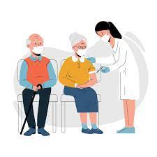
5. Are you ready?
Complete online form re: pharmacy pairing
Read ‘Preparing for vaccination clinics’
Complete Care Home Manager Checklist
Guidance re: ‘Best Interest’ decisions
Provide staff with RQIA registration number if they are being vaccinated in community pharmacy or GP to enable recording

Slide 11
Thank you
Questions

